Slide 1
CanSat 2017 Preliminary Design Review (PDR) Outline Version 1.2
Team # 4773
grizu-263

Slide 2
Presentation Outline
Systems Overview – Muzaffer Duysal
Sensor Subsystem Design – Özgür Tuzcu
Descent Control Design – Ahmet Güngörmüş
Mechanical Subsystem Design – Ahmet Güngörmüş
CDH Subsystem Design – Şems Turgut
Electrical Power Subsystem Design – Özgür Tuzcu
Flight Software Design – Şems Turgut
Ground Control System Design – Şems Turgut
CanSat Integration and Test – Muzaffer Duysal
Mission Operations and Analysis – Muzaffer Duysal
Requirements Compliance – Muzaffer Duysal
Management – Çağla Aytaç Dursun
Presenter: Muzaffer Duysal

Slide 3
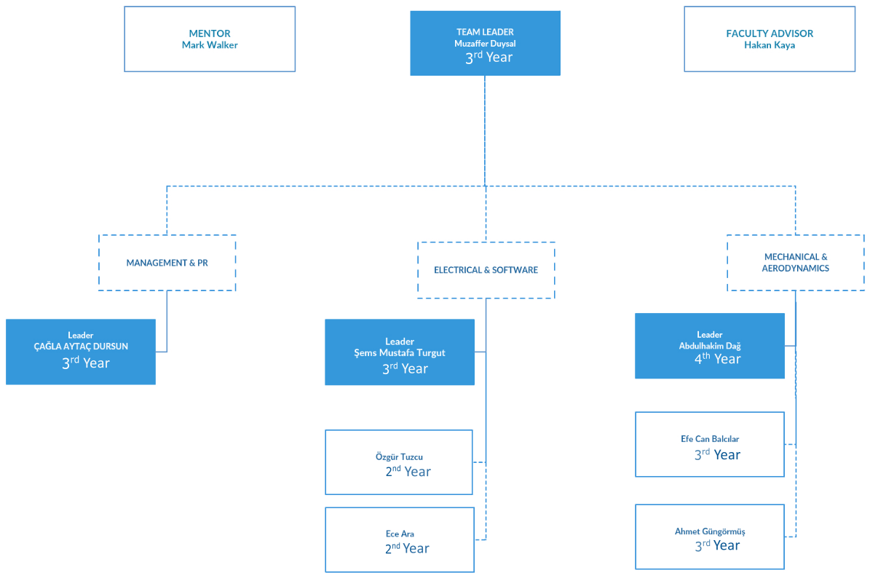
Team Organization
Presenter: Muzaffer Duysal

Slide 4
Acronyms (1 of 2)
A – Analysis
ABS – Acrylonitrile butadiene styrene
CDH – Communication and Data Handling
D – Demonstration
DCS – Descent Control System
EPS – Electrical Power Subsystem
FSW – Flight Software
GCS – Ground Control System
GS – Ground station
I – Inspection
PCB – Print Circuit Board
SV – Science Vehicle
T – Test
VM – Verification Method
RTC – Real Time Clock
SPI – Serial Peripheral Interface
GPS – Global Positioning System
REQ – Requirement
SS – Sensor Subsystem
API – Application Programming Interface
CONOPS – Concept of Operations
EEPROM – Electrically Erasable Programmable Read Only Memory
I2C – Inter – Integrated Circuit
MCU – Microcontroller Unit
Presenter: Muzaffer Duysal

Slide 5
Acronyms (2 of 2)
PC – Personal Computer
RAM – Random Access Memory
USB – Universal Serial Bus
GUI – Graphical User Interface
LED – Light Emitting Diode
LDR – Light Dependent Resistor
HDP – High Density Polycarbonate
RN – Requirement Number
SRN – Subsytem Requirement Number
ADC – Analogue to Digital Converter
DC – Direct Current
TEKRAR GÖZDEN GEÇİRELECEK!!!!!
Presenter: Muzaffer Duysal

Slide 6
Systems Overview
The purpose of this section is to introduce the reviewer to the overall requirements and configuration of the CanSat. This provides a basis for the details presented in the subsystem sections.
Presenter Name(s) Go Here

Slide 7
Mission Summary (1 of 2)
Mission Objectives
CanSat is composed of two parts: A container and a glider.
Container protects the glider, which performs the desired mission.
The launched CanSat will leave the rocket when the rocket arrives at the near apogee.
The container and the glider will separate each other at 400 meters (approx. 1312 feet) and they will continue their decline in the atmosphere independently.
After the glider separates from the container, it will decline in a circular pattern until landing. The diameter should not be more than 1000 meters (approx. 3280 feet).
The glide mission should take about 2 minutes.
During descent, the glider shall collect air pressure, outside air temperature , compass direction, air speed and solar power voltage once per second and time tag the data with mission time.
The glider should provide electricity absolutely from solar power.
An audio beacon for the glider shall be included and powered off of the solar power.
Presenter: Muzaffer Duysal

Slide 8
Mission Summary (2 of 2)
Bonus Objective
A camera with a minimum resolution of 640x480 should be used to take photos of the ground.
The photos should not be transmitted to the ground station, but rather be kept by the glider.
The camera should be fed by the solar panels on the glider. An extra battery is not allowed.
External Objective
As it’s our first experience of CanSat Competition, our aim is to gain knowledge about how satellites operate and to establish a CanSat tradition in our own university.
Presenter: Muzaffer Duysal

Slide 9
System Requirement Summary (1 of 3)
Requirement Number | Requirement | Rationale | Priority | VM
RN-01 | Total mass of the CanSat (container and glider) shall be 500 grams +/- 10 grams. | Competition requirement. | HIGH | I
RN-02 | The glider shall be completely contained in the container. No part of the glider may extend beyond the container. | Competition requirement | HIGH
RN-03 | Container shall fit in a cylindrical envelope of 125 mm diameter x 310 mm length including the container passive descent control system. | Competition requirement. | HIGH
RN-04 | The container shall use a passive descent control system. It cannot free fall. | Competition requirement. | HIGH
RN-05 | The container shall not have any sharp edges to cause it to get stuck in the rocket payload section | Competition requirement. | HIGH
RN-06 | The container shall be a florescent color, pink or orange. | Competition requirement. | HIGH
RN-07 | The rocket airframe shall not be used to restrain any deployable parts of the CanSat | Competition requirement.
Presenter: Muzaffer Duysal

Slide 10
System Requirement Summary (2 of 3)
Requirement Number | Requirement | Rationale | Priority | VM
RN-08 | The rocket airframe shall not be used as part of the CanSat operations. | Competition requirement. | HIGH | I
RN-09 | The CanSat (container and glider) shall deploy from the rocket payload section. | Competition requirement | HIGH
RN-10 | The glider must be released from the container at 400 meters +/- 10 m. | Competition requirement. | HIGH
RN-11 | The glider shall not be remotely steered or autonomously steered. It must be fixed to glide in a preset circular pattern of no greater than 1000 meter diameter. No active control surfaces are allowed. | Competition requirement. | HIGH
RN-12 | Mechanisms shall not use pyrotechnics or chemicals | Competition requirement. | HIGH
RN-13 | During descent, the glider shall collect air pressure, outside air temperature, compass direction, air speed and solar power voltage once per second and time tag the data with mission time. | Competition requirement. | HIGH
RN-14 | During descent, the glider shall transmit all telemetry. Telemetry can be transmitted continuously or in bursts. | Competition requirement. | HIGH
Presenter: Muzaffer Duysal

Slide 11
System Requirement Summary (3 of 3)
Requirement Number | Requirement | Rationale | Priority | VM
RN-15 | Telemetry shall include mission time with one second or better resolution, which begins when the container and glider is powered on. Mission time shall be maintained in the event of a processor reset during the launch and mission | Competition requirement. | HIGH | I
RN-16 | All telemetry shall be displayed in real time during descent. | Competition requirement | HIGH
RN-17 | Teams shall plot each telemetry data field in real time during flight. In addition, the ground system shall display a two dimensional map of estimated glider position based on speed and heading telemetry data | Competition requirement. | HIGH
RN-18 | The ground station shall include one laptop computer with a minimum of two hours of battery operation, XBEE radio and a hand held antenna. | Competition requirement. | HIGH
RN-19 | The glide duration shall be as close to 2 minutes as possible. | Competition requirement. | HIGH
RN-20 | The glider electronics must be all solar powered except for the time keeping device may use a coin cell battery. No batteries are allowed. Super capacitors are allowed and must be fully discharged at launch. | Competition requirement. | HIGH
Presenter: Muzaffer Duysal

Slide 12
System Level CanSat Configuration Trade & Selection
Present two preliminary system-level concepts considered
What configurations were considered
Present criteria for final configuration selection
Include discussion of why the final configuration was selected
Include sketches and diagrams of various concepts considered
Diagrams of non-selected configurations can include sketches of physical layouts (e.g. scans of hand sketches rather than CAD drawings)
Include variations on CONOPS considered
Limit discussions to 1-2 slides per preliminary configuration
Presentation of the material may be at a cursory level (hit the highlights)
Each concept will be scored separately.
Presenter: Name goes here

Slide 13
Physical Layout
Diagram(s) showing physical layout of selected CanSat configuration
Make sure to include:
Dimensions
Placement of major components
Sensors, electronics, radio, power, mechanisms
Relevant configurations
Container, Payload, launch configuration, deployed configuration.
The goal is to present the physical idea of what the CanSat will look like for reference prior to getting into details of the design
Presenter: Name goes here

Slide 14
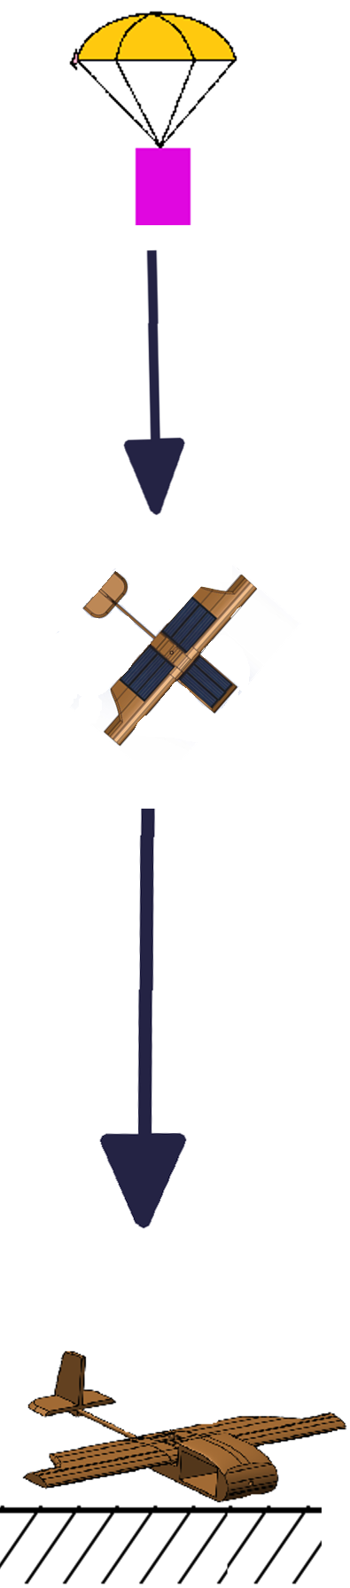
System Concept of Operations
Post-launch recovery
If proccesor reset during mission(descent and flight), processor get important datas(mission time,packet count) from EEPROM.
After finding CanSat,saving SD card datas(pictures) on GCS and giving all datas(SD card pictures,.csv from GCS) to competition coordinators.
Data reduction
After mission we will check telemetry datas on GCS via .csv file. Finding plot outliers and mark them.
After saving SD card pictures on GCS, we’ll check numbers of pictures and the quality of pictures.
Presenter: Name goes here

Slide 15
Launch Vehicle Compatibility
Include a dimensioned drawing that shows clearances with the payload section
Focus on launch configuration (Container + Payload)
Include all descent control apparatus (no sharp protrusions)
At PDR this may be allocated dimensions (if this is the case, these should be requirements at the system and subsystem levels)
What is the clearance? (Leave margin to allow easy deployment!)
Note:
In past years there were a large number of CanSats that did not deploy from the payload sections of the rocket because of protrusions or because the CanSat was too wide to fit in the rocket
Lack of sharp protrusions and fit within the Launch Vehicle will also be scored at the Flight Readiness Review
Presenter: Name goes here

Slide 16
Sensor Subsystem Design
Presenter Name(s) Go Here

Slide 17
Sensor Subsystem Overview
Model | Location | Sensors | Description
10-DOF IMU | Glider, Container | Magnetometer, Air Pressure, Air Temperature | This sensor used for Gyro, pressure and temperature. Only for glider.
LM2577 LM2596 | Glider | Voltage Regulator | Ends with 77 is for step up, 96 is for step down voltage.
Pixhawk PX4 AirSpeed Sensor | Glider | Pitot Tube | Used for measure speed.
B25 | Glider, Container | Voltage Sensor | Measuring voltage.
OV7670 | Glider | Camera | Capturing image.
Presenter: Name goes here

Slide 18
Sensor Subsystem Requirements
Number | Desciption | Rationale | Priority | VM
RN#10 | The glider must be released from the container at 400 meters +/- 10 m. | Competition Requirement | LOW | T,I,D
RN#21 | During descent, the glider shall collect air pressure, outside air temperature, compass direction, air speed and solar power voltage once per second and time tag the data with mission time. | Competition Requirement | HIGH | T,I,D
RN#27 | The glider electronics must be all solar powered except for the time keeping device may use a coin cell battery. No batteries are allowed. Super capacitors are allowed and must be fully discharged at launch. | Competition Requirement | HIGH | I,A
RN#39 | The container shall contain electronics and mechanisms to release the glider at the required altitude. | Competition Requirement | MEDIUM | T,I,A,D
SSR#1 | If possible CanSat data collector sensors shuold be all-in-one type sensors. | Gaining Money,Time,Space,Weight | HIGH | I,A
SSR#2 | Camera sensors should be has FPS value while capturing pictures. | Higher FPS rate is require lowest cpu need. | MEDIUM | I,A
Presenter: Name goes here

Slide 19
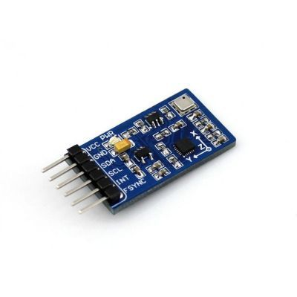
Magnetometer Trade & Selection
Model | Voltage | Resolution | Interface | Weight | Cost
10-DOF IMU | 3.3V | 16 Bit | I2C | 8.5 g | 17.40 $
MPU 9250 | 3.3V | 16 Bit | I2C/SPI | 0.8 g | 11 $
LIS3MDL | 3.3V | 16 Bit | I2C/SPI | 0.6 g | 5.20 $
Selected Magnetometer Sensor: Adafruit 10-DOF IMU (MPU9255 + BMP180)
Useful all in one sensor packet.Include gyro and pressure sensor with magnetometer.
Presenter: Name goes here

Slide 20
Payload Air Pressure Sensor Trade & Selection
Model | Connection Type | Supply Voltage | Weight | Size | Resolution | Cost
BMP 180 | I2C | 3.3V | 0.4 g | 14x12 mm | 0.03 hPa | 3.90 $
10-DOF IMU | I2C | 3.3 V | 8.5 g | 31.2x17mm | 0.03 hPa | 17.40 $
POLOLU LPS331AP | I2C/SPI | 3.3 V | 0.6 g | 10x23 mm | 0.02 kPa | 5.95 $
Selected Playload Air Pressure Sensor: Adafruit 10-DOF IMU (MPU9255 + BMP180)
Include Gyro and Magnotometer with BMP180 pressure sensor
Can be I2C communaction
Low voltage and current values
Presenter: Name goes here

Slide 21
Container Air Pressure Sensor Trade & Selection
Model | Connection Type | Supply Voltage | Weight | Size | Resolution | Cost
BMP 180 | I2C | 3.3V | 0.4 g | 14x12 mm | 0.03 hPa | 3.90 $
10-DOF IMU | I2C | 3.3 V | 8.5 g | 31.2x17mm | 0.03 hPa | 17.40 $
POLOLU LPS331AP | I2C/SPI | 3.3 V | 0.6 g | 10x23 mm | 0.02 kPa | 5.95 $
Selected Container Air Pressure Sensor: Adafruit 10-DOF IMU (MPU9255 + BMP180)
Work high measurement
Low current and valtage value
I2C interface
Presenter: Name goes here

Slide 22
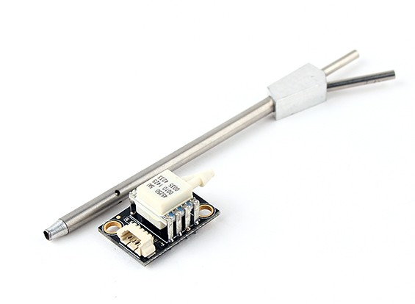
Payload Pitot Tube Trade & Selection
Model | Voltage | Interface | Range | Resolution | Cost
Pixhawk PX4 AirSpeed Sensor | 5V | I2C | Max 8 kPa | 0.84 Pa | 49.44 $
EAGLE TREE AirSpeed MicroSensor V3 | 4 to16 V | Analog | 9 KPH to 350KPH | 1 kPa | 42.99 $
MPXV7002 | 0.5 to 4.5 V | ADC | Max 7 kPa | 1 kPa | 21.28 $
Selected Payload Pitot Tube : Pixhawk PX4 AirSpeed Sensor
Easy availability
Low power consumption
Sensitivity
Presenter: Name goes here

Slide 23
Payload Air Temperature Sensor Trade & Selection
Model | Voltage | Current | Range | Interface | Cost
BMP180 | 4.25 V (Max) | 5 uA | -40 °C to +85 °C | I2C | 3.90 $
10-DOF IMU | 3.3V | 3.2 mA | -40 °C to +85 °C | I2C | 17.40 $
LM35 | 4 to 30 V | Less 60 uA | -55 °C to +150 °C | Analog | 1.5 $
Selected Payload Air Temperature Sensor: Adafruit 10-DOF IMU (MPU9255 + BMP180)
Include Air Pressure, Air Temperature and Magnetometer sensors.
Low used voltage value.
Presenter: Name goes here

Slide 24
Container Air Temperature Sensor Trade & Selection
Model | Size | Supply Voltage | Interface | Resolution | Range | Cost
10-DOF IMU | 31.2x17mm | 3.3V | I2C | ±0.5°C | -40 to +85 °C | 17.40 $
MCP9808 | 21 mm x 13 mm | 5V | I2C | ±0.25°C | -40°C to +125°C | 4.95 $
SI7021 | 13mm x 10mm | 3.3V | I2C | ±0.4℃ | -40 ℃ to +85 ℃ | 6.95 $
Selected Container Air Temperature Sensor: Adafruit 10-DOF IMU (MPU9255 + BMP180)
I2C interface
Include Air Pressure, Air Temperature and Magnetometer sensors.
Presenter: Name goes here

Slide 25
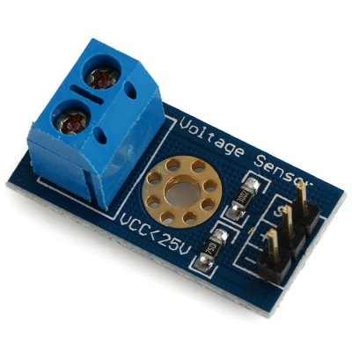
Payload Solar Power Voltage Sensor Trade & Selection
Model | Range | Pros | Cost
Arduino ADC Voltage Divider | 0-50V | Almost no weight and size. | $0
B25 Voltage Sensor | 0-25V | Much more solid design and it needs less code. | $1
Selected Payload Solar Power Voltage Sensor: B25 Voltage Sensor
Much more solid design.
It needs less code.
Presenter: Name goes here

Slide 26
Container Battery Voltage Sensor Trade & Selection
Model | Range | Pros | Cost
Arduino ADC Voltage Divider | 0-50V | Almost no weight and size. | $0
B25 Voltage Sensor | 0-25V | Much more solid design and it needs less code. | $1
Selected Container Solar Power Voltage Sensor: B25 Voltage Sensor
Much more solid design.
It needs less code.
Presenter: Name goes here

Slide 27
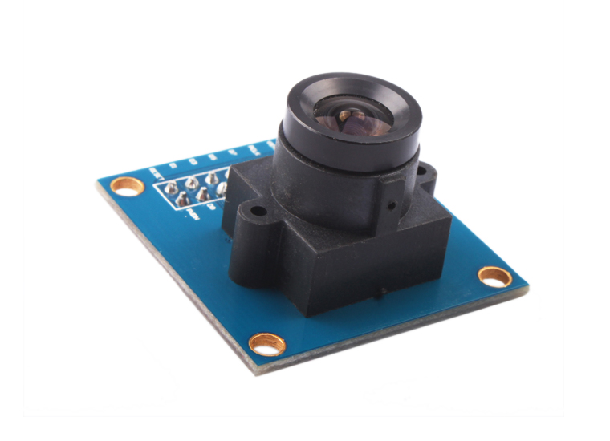
Bonus Camera Trade & Selection
Camera Sensor | Resolution | Power Cost | Maximum Image Transfer Rate | Cost
OV7670 | 640x480 | 49,5 mW | 30 fps for VGA | 14 $
OV2640 | 1600x1200 | 140 mW | 15 fps UXGA | 25.99 $
Selected Camera: Omnivision OV7670
Less power usage.
Much more faster image transfer rate.
Presenter: Name goes here

Slide 28
Descent Control Design
Presenter Name(s) Go Here

Slide 29
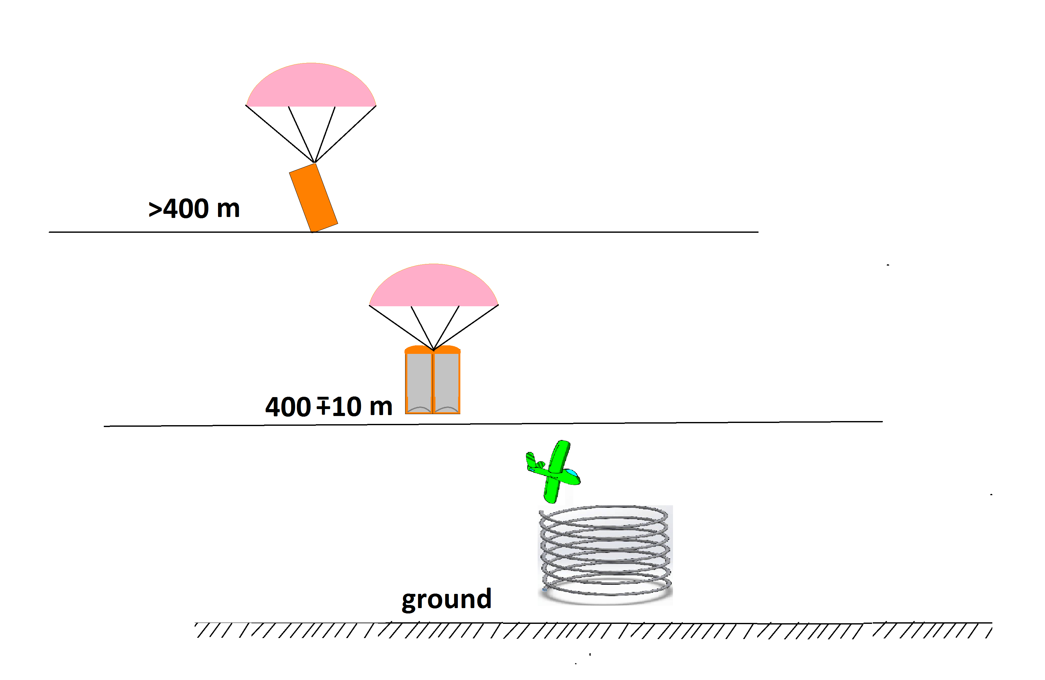
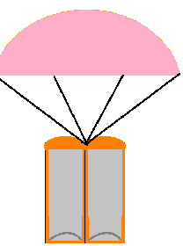
Descent Control Overview
Container with parachute
(glider inside container)
glider separation
from container
glider is circling
in a spiral

Slide 30
Descent Control Requirements
 | Container Requirements
Number | Desciption | Rationale | Priority | VM
RN #3 | Dimensions of container based on requirement to fit inside envelope of 12.5 cm diameter X 31 cm length. | Competition requirement. | HIGH | I
RN #4 | The container shall use a passive descent control system. It cannot free fall. A parachute is allowed and highly recommended. Include a spill hole to reduce swaying. | Competition requirement. | HIGH | A,I,T
RN #5 | The container shall not have any sharp edges to cause it to get stuck in the rocket payload section. | Competition requirement | HIGH | I
RN #6 | The container must be a florescent color, orange or pink. | Competition requirement. | HIGH | I
RN #8 | The rocket airframe shall not be used as part of the CanSat operations. | Competition requirement. | HIGH | I

Slide 31
Descent Control Requirements
 | Glider Requirements
Number | Desciption | Rationale | Priority | VM
RN #2 | The glider shall be completely contained in the container. No part of the glider may not extend beyond the container. | Competition requirement. | HIGH | I
RN #11 | The glider shall not be remotely steered or autonomously steered. It must be fixed to glide in a preset circular pattern of no greater than 1000 meter diameter. No active control surfaces are allowed. | Competition requirement. | HIGH | A I D
RN #12,13 | All descent control devices and attachment components must survive 30 Gs of shock withstand. | Competition requirement. | HIGH | A T D
RN #46 | The container shall transmit telemetry from the time being turned on and placed on the aunch pad until 2 seconds after releasing the glider. | Competition requirement. | HIGH | A T
RN #12 | All descent control device attachment components shall survive 30 Gs of shock. | Competition requirement | HIGH | A T D

Slide 32
Container Descent Control Strategy Selection and Trade
Topic | Container materials | DCS connections | Color selection | Parachute | Preflight Review Testability
Options | -ABS(3D Printer) -Kestamide -Carbon Fiber -HDP | -Servomechansm -Tire -Screw -Hinge | -Fluorescent Pink -Fluorescent Orange | -Conical spill hole -Round spill hole | -Yes -No
Our choıce | -ABS(3D Printer) | -Servomechanism and tire connected | -Fluorescent Orange | -Round spill hole | -Yes
Reason | -Strong, inexpensive, light and better at absorbing impact energy than other materials | -Easiest, fastest to separate with servo and tire mechanism. | -Fluorescent orange color for high visibility. -Easy to see in grass. | -Simple to create -Past experience with this mechanism -Meets all competition requirements | Because: All parts will be rigorously tested to specification given the competition guide.
In our parachute this umbrella is large and round.Made from 100% nylon lightweight and durable fabric that does airtight.
There is a small hole in the middle.A part of the air to go out with this hole.If all the air is stay in parachute,
the paratrooper goes to the side not just down.

Slide 33
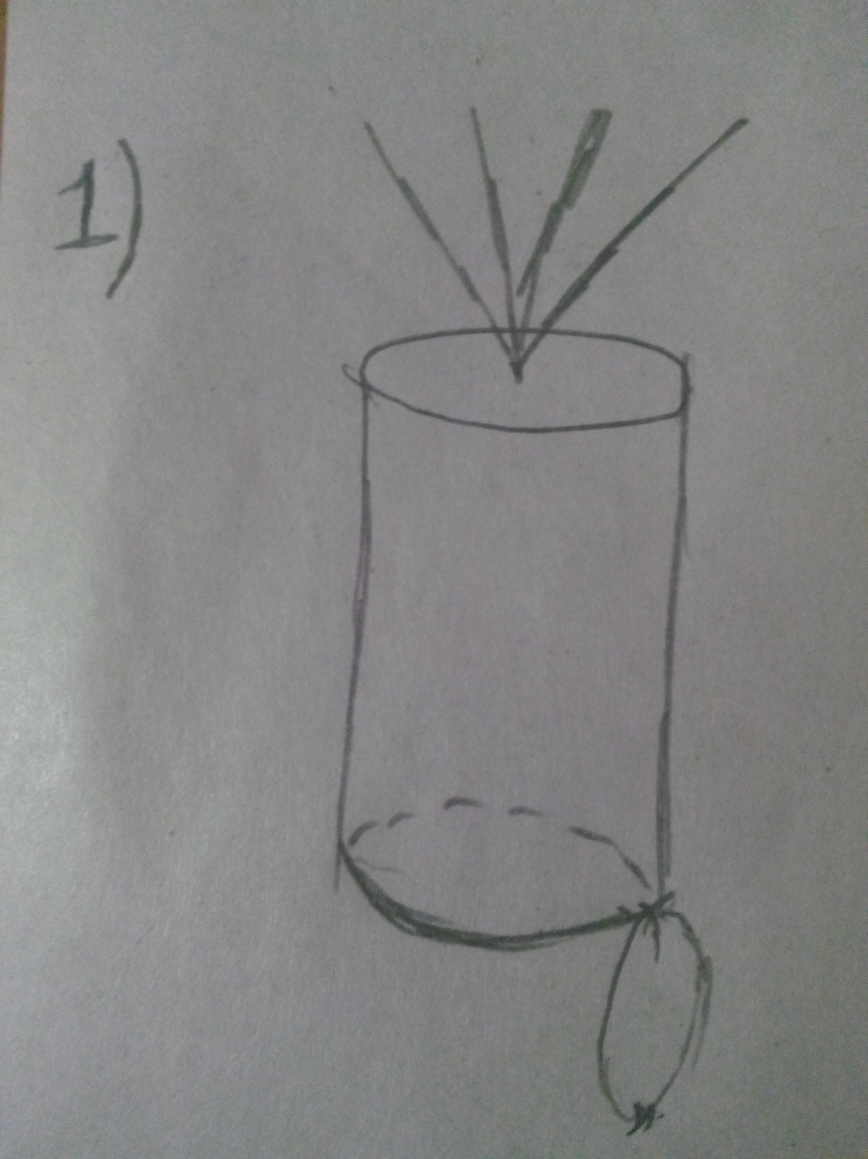
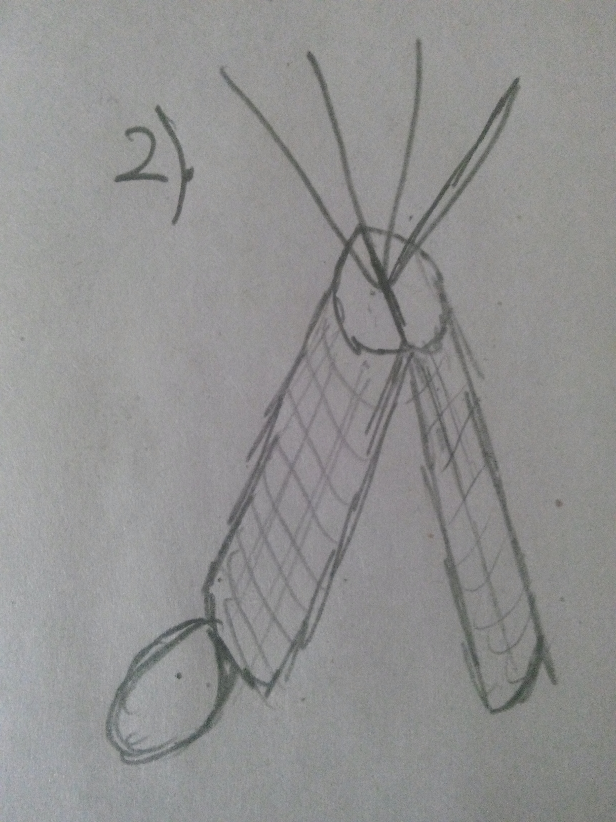
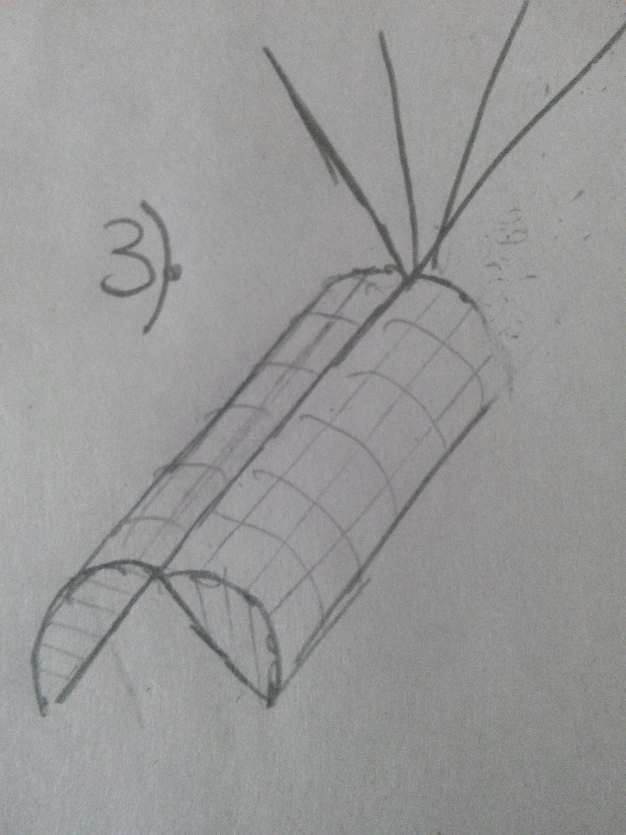
Container Descent Control Strategy Selection and Trade
Three different opening systems of container :
We chose the third design.
Because, The glider must fly in the fastest mode and take the sun's rays.
There is no risk of the planner staying in the container

Slide 34
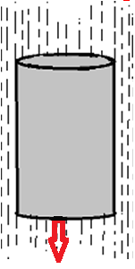
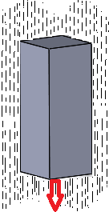
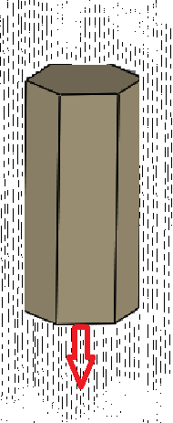
Container Descent Control Strategy Selection and Trade
FOM | In percentage (%) | Cylinder | Square | Hexagonal Prism
Volume available | % 25 | 3 | 1 | 2
Strenght | %15 | 1 | 2 | 3
Ease of seperation | %15 | 3 | 2 | 1
Simplicity | %10 | 3 | 2 | 1
Lightness | % 35 | 1 | 2 | 3
Total Results | %100 | 2.2 | 1.8 | 2
The options are graded according to the figure of merits. 3 is the best grade and 1 is the worst. The result score is the weighted average of the grades. So we selected the cylinder.

Slide 35
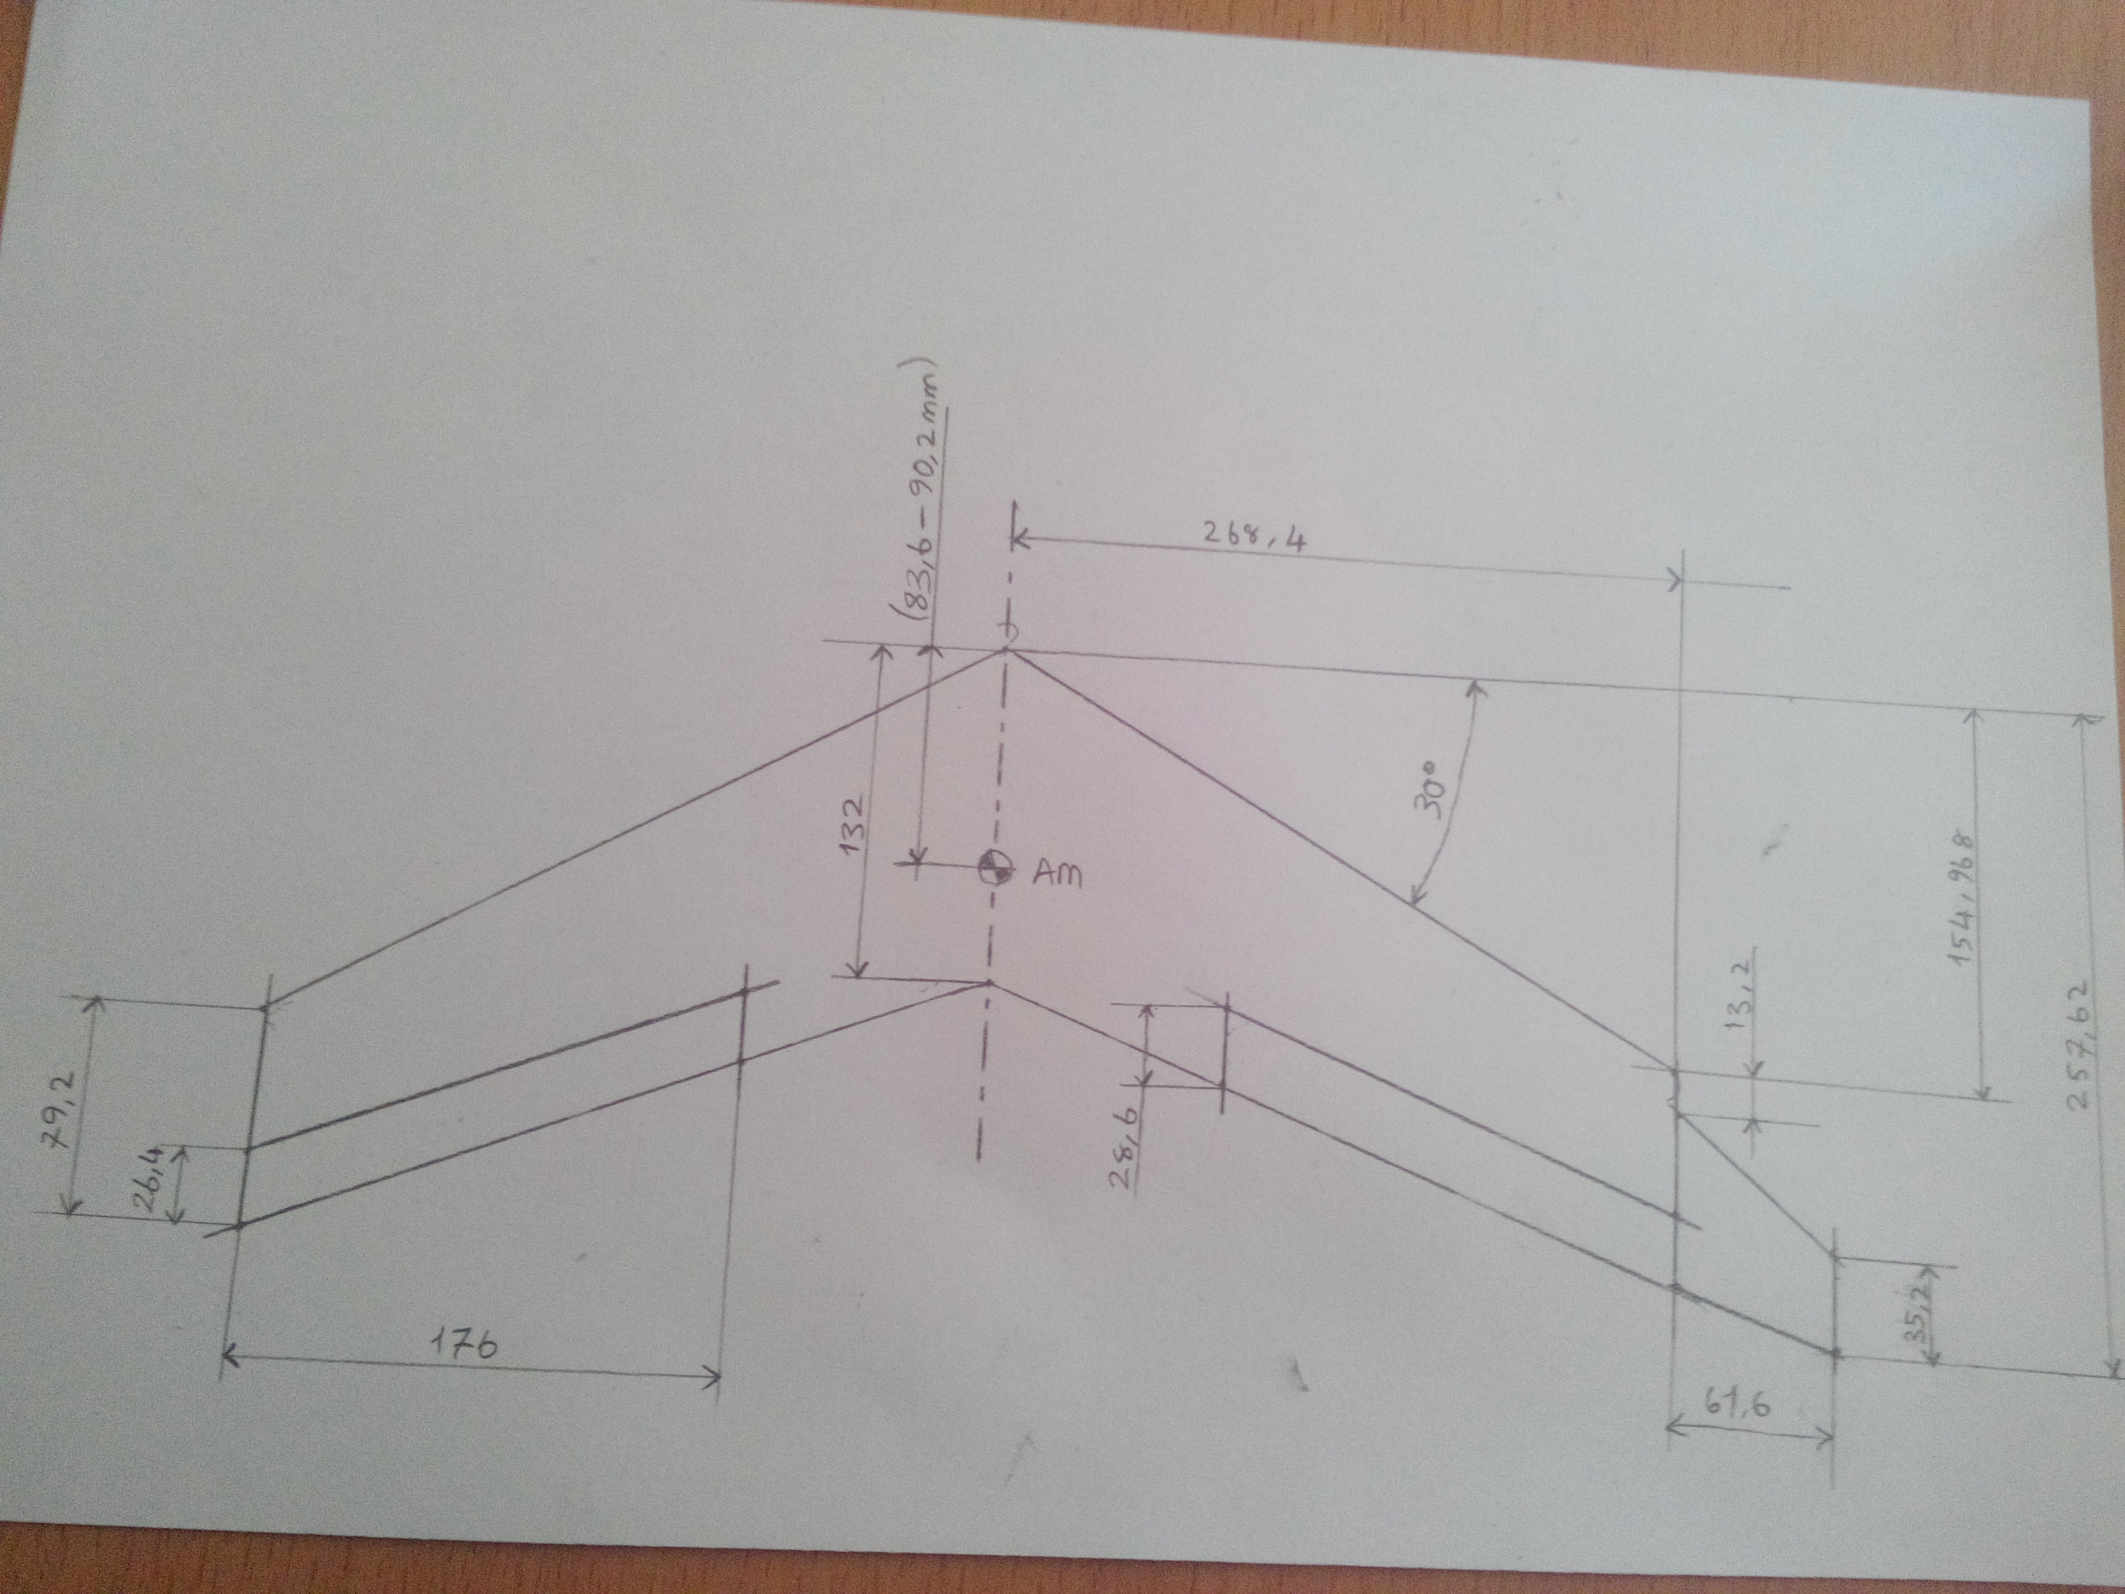
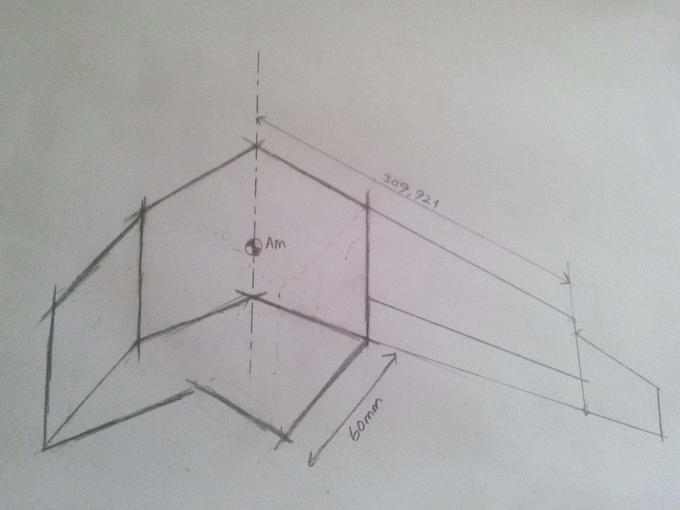
Payload Descent Control Strategy Selection and Trade
Glider Configuration-1 Delta (Flying wing)
Properties | Fuselage type = Depron Surface wing: Balsa 1/4inch thick Foldable flat triangular wings Fuselage length = ??? Fusalage hıgh: ??? Wing area = ???? Wing span = ???
Superiority | suitability to aircrafting applications Easy to mount electronics and solar panel Easy to Fabricate. cheaper
Deficiency | It's hard to fold the wing surface area is not enough Difficult to meet container dimensions

Slide 36
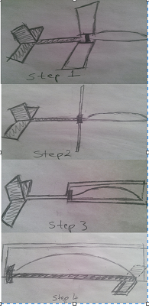
Payload Descent Control Strategy Selection and Trade
Glider Configuration-2
Properties | Fuselage type =Balsa 1/4 inch Wing type: Balsa 1/8 inch thick Fuselage length = 54 cm Fusalage hıgh: ??? Wing area = (2x197.1) cm^2 Wing span = 58 cm
Pros | suitability to aircrafting applications Cheaper surface area is enough
Deficiency | It's hard to fold the wing Heavy fuselage Not Easy to mount electronics and solar pane Hard to fabricate

Slide 37
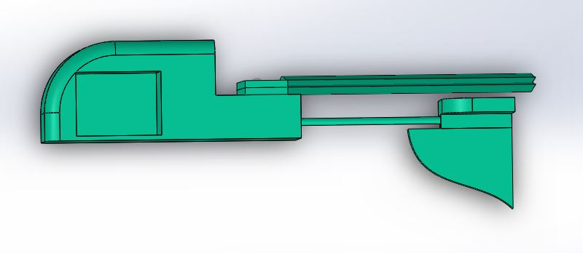
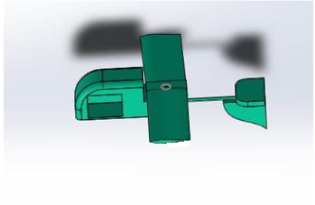
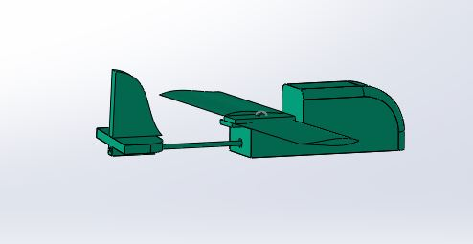
Payload Descent Control Strategy Selection and Trade
Glider Configuration-3
Properties | Fuselage type =foam Wing type: ABS flament(3D printer) and depron Fuselage length = ??? cm Wing area = (?????) Wing span = ?????
Superiority | suitability to aircrafting applications Cheaper surface area too high light fuselage and wings
Deficiency | Difficulty in manufacturing precise measurements easy to fabricate

Slide 38
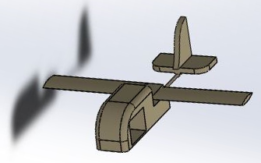
Payload Descent Control Strategy Selection and Trade
Chosen | Rationale
Glider Configuration-3 | Complies with dimensioning constraints too much surface area of the panel Better materials for shock absorbency Lifting force is greater
4. SEÇİM ASIL PLANÖR
EKLENECEK KIYASLANACAK

Slide 39
Descent Rate Estimates
Container landing account
The parachute will be used to control the speed of the container's descent.
R= √2F_{drag}/πρv²C_{d} v= Landing speed (m/s)
F_{drag}= mg (Frictional force) (N)
π= 3,14159265359
C_{d}= 0,5 (Drift coefficient)
R= Radius (m)
ρ= Air density at 25 ° C (1,189 kg/m3)
The fall speeds are calculated for the container + glider and container case according to the parachute Radius.

Slide 40
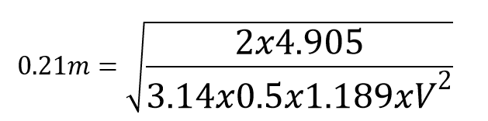
Descent Rate Estimates
Speed ​​of landing in case of container + glider.
C_{d}= 0,5 (Drift coefficient)
R= 21cm= 0.21m
F_{drag}= Container + glider (0.500kg x 9.81m/s²)
V= Approximate descent speed 10.91m/s
Speed ​​of landing in case of container.
C_{d}= 0,5 (Drift coefficient)
R= 21cm= 0.21m
F_{drag}= Container + glider (0.350kg x 9.81m/s²)
V= Approximate descent speed 9.13m/s

Slide 41
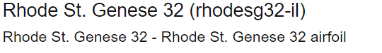
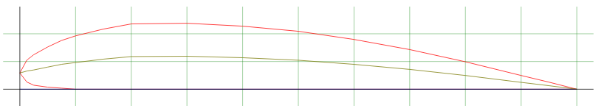
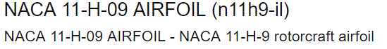
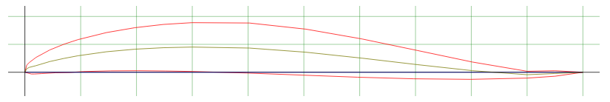
Descent Rate Estimates
Two wing profiles were discussed. Rhode St. Genese 30 (RhodesG32-il) was considered suitable for draining because it has a half-drop profile similar to the wing profile. NACA 11-H-09 AIRFOIL (n11h9-il) wing profile is not preferred because it is used in aerobatic aircraft

Slide 42
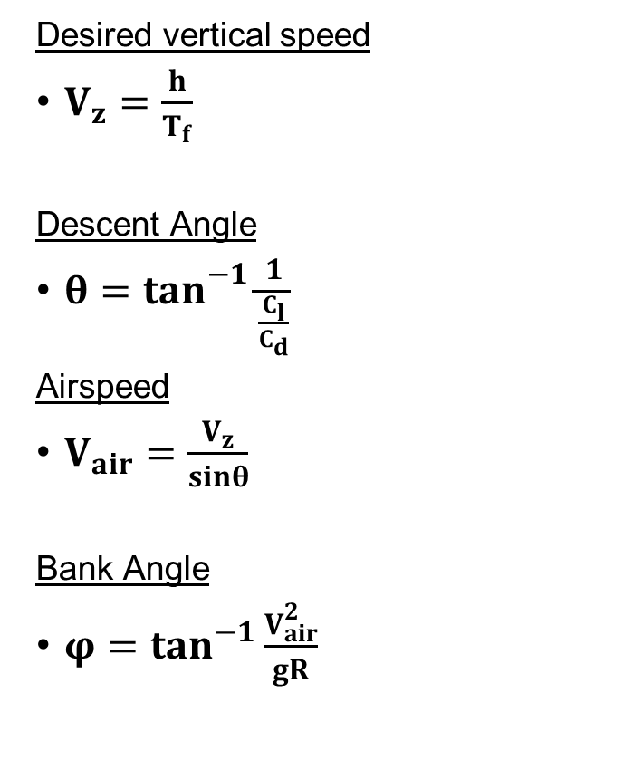
Descent Rate Estimates
Desired vertical speed
$V_{z}=\frac{h}{T_{f}}$
Descent Angle
${θ=tan}^{−1}\frac{1}{\frac{C_{l}}{C_{d}}}$
Airspeed
$V_{air}=\frac{V_{z}}{sinθ}$
Bank Angle
$φ=\tan^{−1}\frac{V_{air}^{2}}{gR}$
Descriptions
h | Vertical Height | 400 m
T_{f} | Flight Time | 120 s
b | Wing Span | 39 cm
R | Circular Radius | 300 m
ρ | Air Density | 1.189 m/s²
g | Gravity | 9.81 m/s²
w | Weight | 1.4715 m/s²
C_{d} | Drag Coefficient | 0.06161
C_{l} | Lift Coefficient | 0.6398

Slide 43
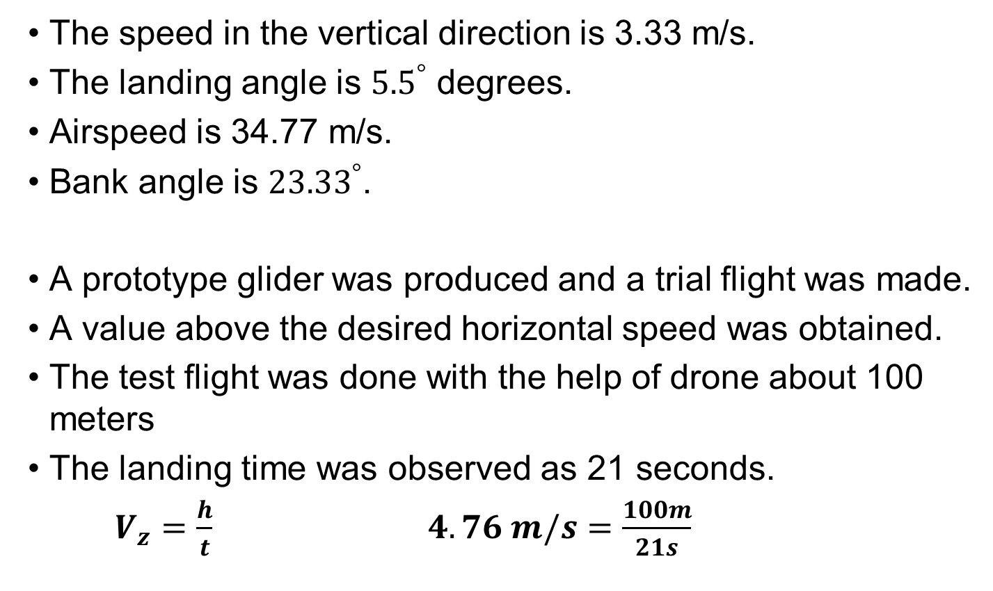
Descent Rate Estimates
The speed in the vertical direction is 3.33 m/s.
The landing angle is ${5.5}^{°}$ degrees.
Airspeed is 34.77 m/s.
Bank angle is ${23.33}^{°}$.
A prototype glider was produced and a trial flight was made.
A value above the desired horizontal speed was obtained.
The test flight was done with the help of drone about 100 meters
The landing time was observed as 21 seconds.
$V_{z}=\frac{h}{t}$ $4.76 m/s=\frac{100m}{21s}$

Slide 44
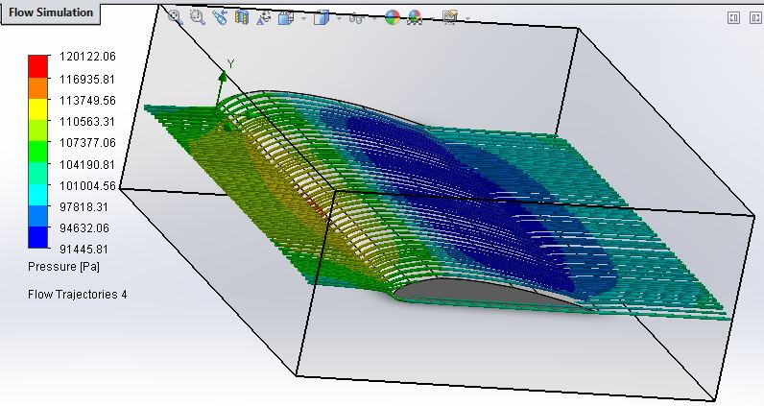
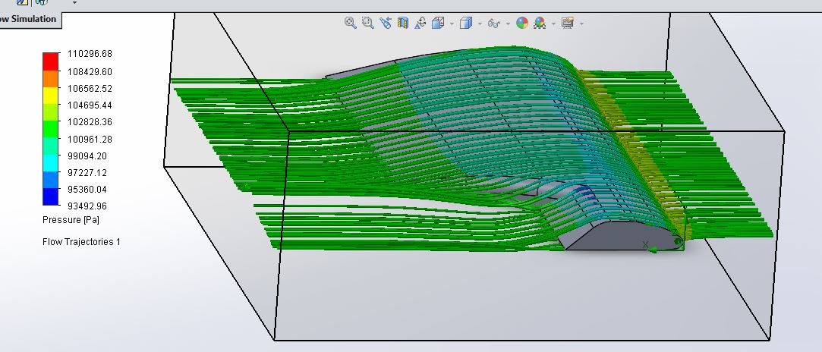
Descent Rate Estimates
We did the flow simulation to improve the flight.
While in the container, the wings will stand on top.
Since rudder is fixed we decided to cut the edges of the wings.
We have observed that this cut does not have a great effect on the flow.

Slide 45
Mechanical Subsystem Design
Presenter Name(s) Go Here

Slide 46
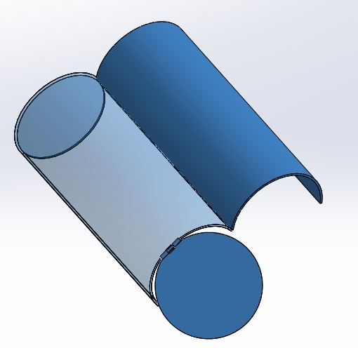
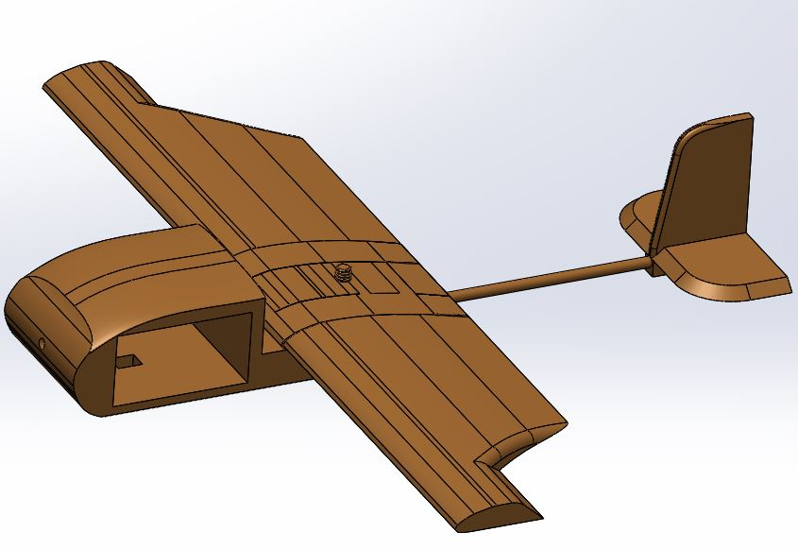
Mechanical Subsystem Overview
CONTAİNER:
12mm diameter by 31 cm lenght.
Material ABS 3D printer.
Painted a bright fluorescent orange.
We chose a cylindrical geometry.
We used an alkaline battery.
No solar panel on the container
PAYLOAD:
25 cm length with 30 cm wing span
Wings will use (rohodes g36-il) ROHODE St. GENESE 36 airfoil
Fuselage will be constructed from foam
ABS flament(3D printer) and depron
The electronics are enclosed in a inside the fuselage of the glider with opening at the bottom part to place the camera.
The Pitot Tube is placed in the nose of the glider.
Foldable Wings are used in the glider to save space.

Slide 47
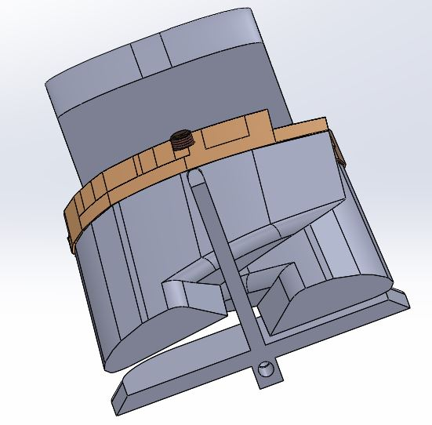
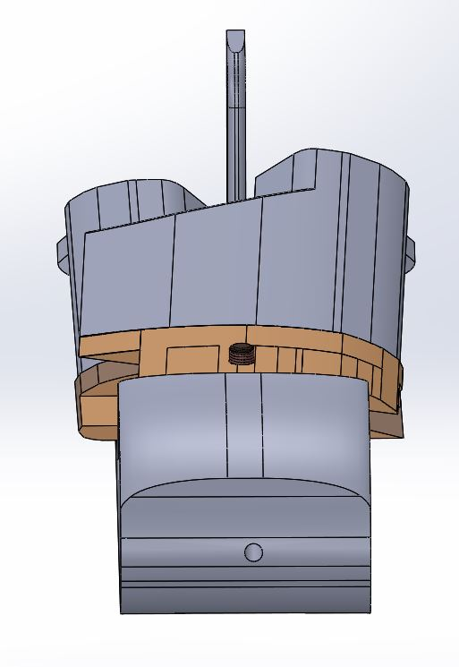
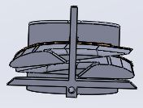
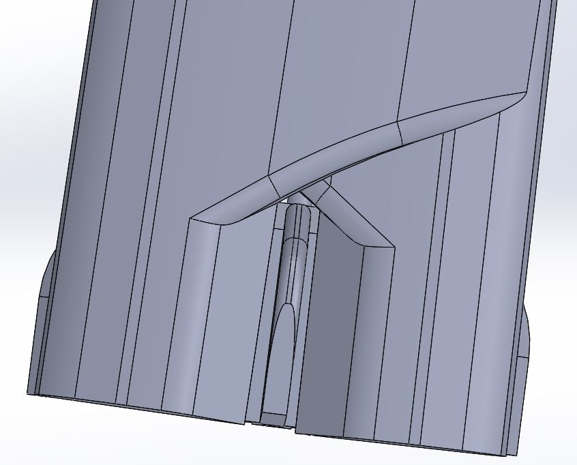
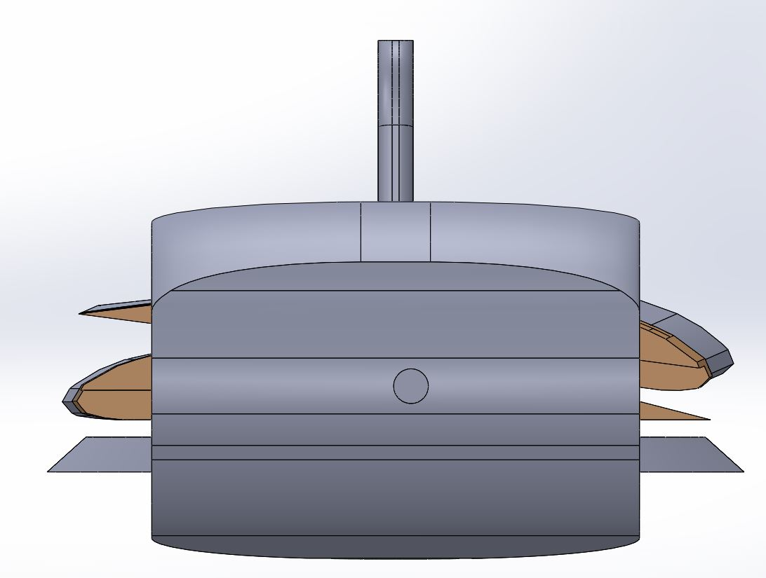
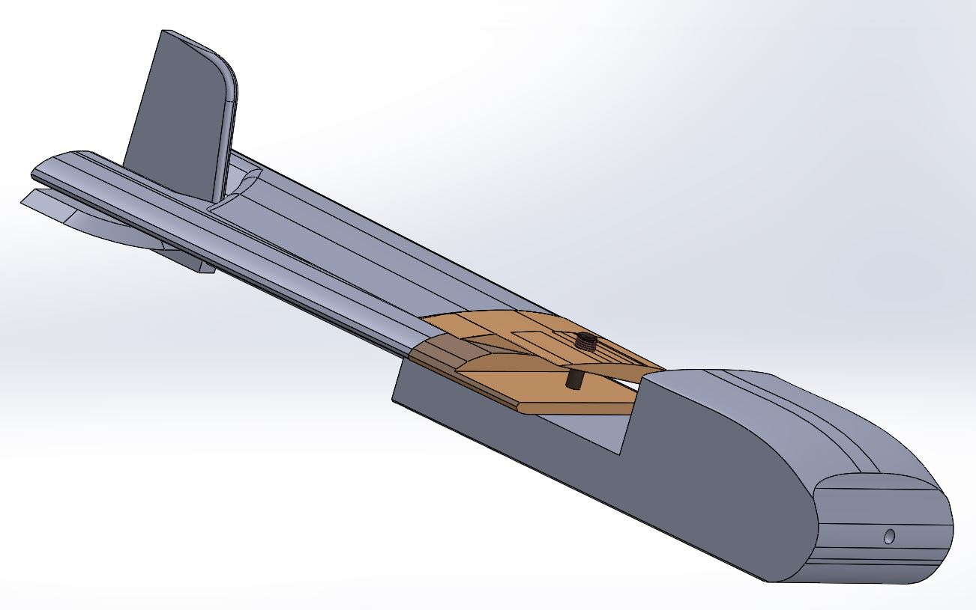
Mechanical Subsystem Overview
Glider details
Her resım altına görunusler
eklenecek ve kısa cumleler kurulacak

Slide 48
Mechanical Sub-System Requirements
Payload Mechanical Subsystem Requirements | Number
The glider shall be completely contained in the container. No part of the glider may extend beyond the container. | SRN #2
The glider shall not be remotely steered or autonomously steered. It must be fixed to glide in a preset circular pattern of no greater than 1000 meter diameter. No active control surfaces are allowed. | SRN #11
All descent control device attachment components shall survive 30 Gs of shock. | SRN #12
All descent control devices shall survive 30 Gs of shock. | SRN #13
The glide duration shall be as close to 2 minutes as possible. | SRN #41
Container Mechanical Subsystem Requirements | Number
Container shall fit in a cylindrical envelope of 125 mm diameter x 310 mm length including the container passive descent control system. Tolerances are to be included to facilitate container deployment from the rocket fairing. | SRN #3
The container shall use a passive descent control system. It cannot free fall. A parachute is allowed and highly recommended. Include a spill hole to reduce swaying. | SRN #4
The container shall not have any sharp edges to cause it to get stuck in the rocket payload section. | SRN #5
The container shall be a florescent color, pink or orange. | SRN #6
The rocket airframe shall not be used to restrain any deployable parts of the CanSat. | SRN #7
The rocket airframe shall not be used as part of the CanSat operations. | SRN #8
Cost of CanSat will be less than $1000 | SRN #17

Slide 49
Payload Mechanical Layout of Components Trade & Selection
Material Selection
Part | Material | Chosen | Reason
Container | -ABS(3D Printer) -Kestamide -Carbon Fiber -HDP Fiberglass | -Fiberglass | -Strong, inexpensive, light and better at absorbing impact energy than other materials
Glider’s fuselage | -Foam -Balsa | -Foam | Very light weight
Glider’s wings | -Foam -Balsa -ABS(3D Printer) | -Foam+ABS | Very light weight and strong
Glider’s tail | -Foam -Balsa -ABS | Balsa | More light weight than ABS and more strenght than foam

Slide 50
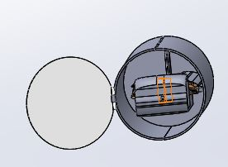
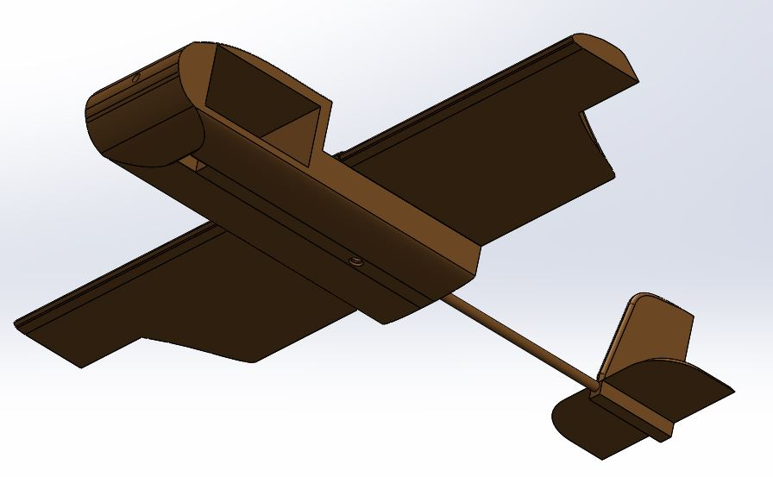
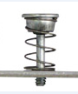
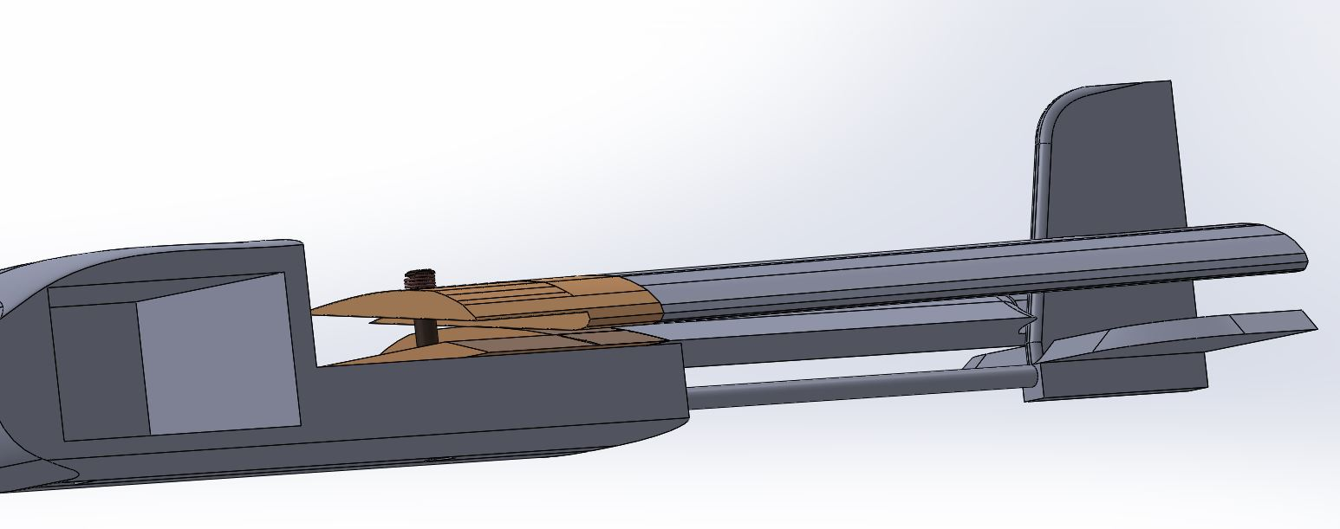
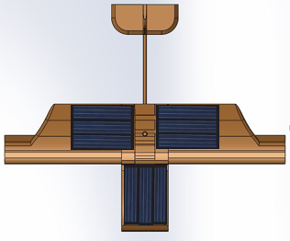
Payload Mechanical Layout of Components Trade & Selection
electrical components
Pitot tube
hole»»
duzenlenecek
Camera connection
Hole
spring pin
Solar panels
ABS flement ( 3D printer )
Foam(depron)
Balsa
cane

Slide 51
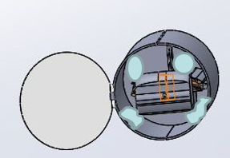
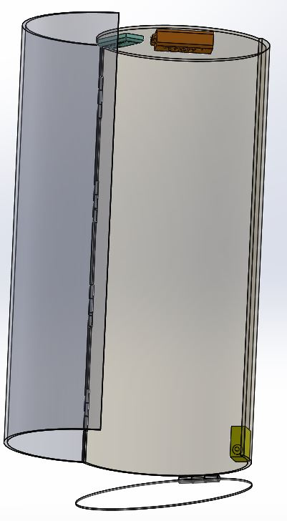
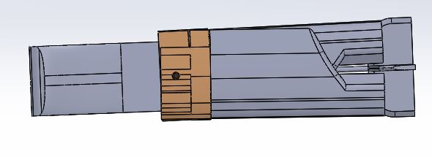
Payload Pre Deployment Configuration Trade & Selection
– The glider is supported by foam so that it does not move in the container
– The wings of the planer are folded backwards with the help of a spring pin and placed in the container
Foam supports for glider
DERLENİP NOT KOYULACAK
– Alkaline battery and electrical box do not touch to rudder and glider’s other parts

Slide 52
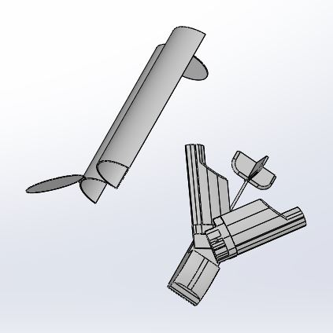
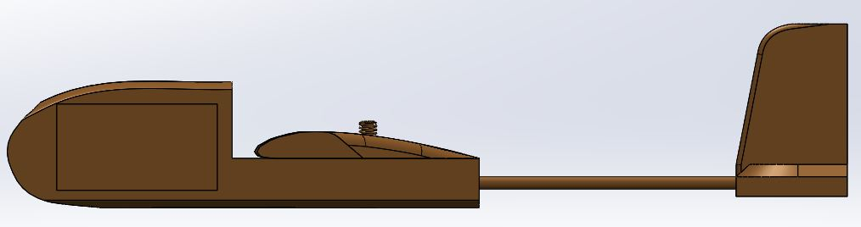
Payload Deployment Configuration Trade & Selection
– The container is opened with the hinge and tire system and the glider is released
– The released glider goes into flight position with the tire and spring pin mechanism
DERLENİP TEKRAR YERLERI DUZENLENIP METIN ILE ZENGINLESTIRIRLECEK

Slide 53
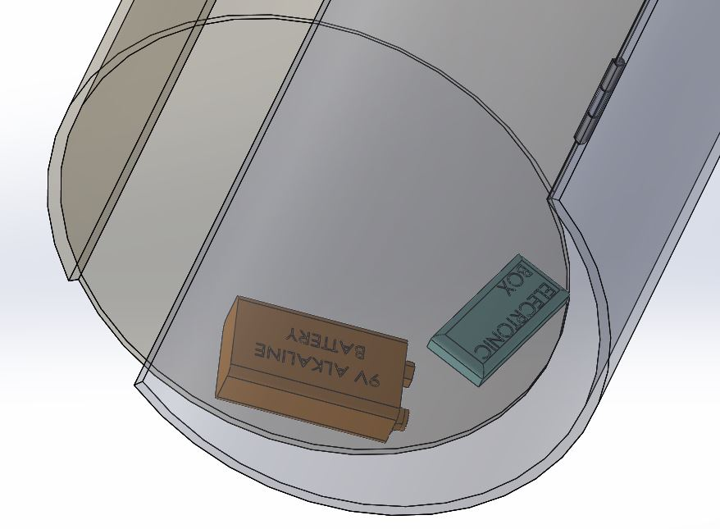
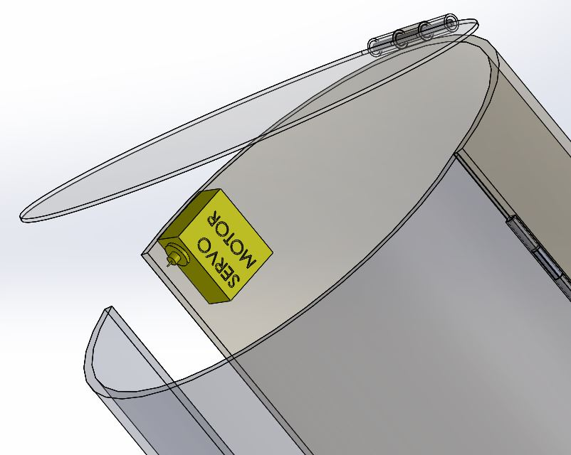
Container Mechanical Layout of Components Trade & Selection
– When the opening mechanism with servo motor is released, it will be opened by taut tires outside the container
– Electronic components like PCB board,battery and servo engine and will be mounted to the container with high performance adhesives
– Container is not transparent like pictures
Fixed top
cover
Top
Hinge and pin
Opening
bottom cover
Bottom
Part | Material | Chosen | Reason
Container | -ABS(3D Printer) -Kestamide -Carbon Fiber -HDP Fiberglass | -Fiberglass | -Strong, inexpensive, light and better at absorbing impact energy than other materials

Slide 54


Payload Release Mechanism
The glider is fixed with half discs of 10 mm thickness fixed to the container.
These discs contain material Foam (Depron)
On top of the opened lid there is a stopper inside the nose to stop the glider.
This system ensures that the glider remains stationary within the container.
The second servo is not used.
Algoritma tarzi diyagram eklenecek.

Slide 55
Electronics Structural Integrity
Descent control system:
We used parachute at descent control for soft landing
Electronics mounting:
–Electronic components like PCB board and camera module will be mounted to the fuselage with high performance adhesives
– Protection of casing ensures security of electronic components integrated into the CanSat
–This was chosen to satisfy – RN #17
Electronics Enclosure
–Epoxy and silicon will used to ensure extra security and electrical insulation
– Pitot tube will be glued to payload
– Protection of casing ensures security of electronic components integrated into the CanSat
Electronic Connections
–Electronic connectors will be secured using hot glue
Requirements
–All structures must survive 30 Gs of shock – RN #16
–All structures must be built to survive 15 Gs of acceleration – RN #15

Slide 56
Mass Budget
GLİDER
Part | Mass | Determination
MCU | 7 g | Estimated
RTC | 10 g | Estimated
Camera | 12 g | Estimated
SD Card Module | 6 g | Estimated
Pitottube | 15 g | Estimated
Buzzer | 3 g | Estimated
Radio module | 8 g | Estimated
Solar Pannels | 7 g | Estimated
Custom PCB board | 35 | Estimated
Wiring | 10 g | Estimated
10-DOF IMU Sensor package | 10 g | Estimated
super capacitor battery circuit | 15 g | Estimated
Empennage | 32,4 | CAD Measured
Rod | 5,1 g | CAD Measured
Fuselage | 14 g | CAD Measured
Wings | 21,84 g | CAD Measured
Connection components | 9,2 g | CAD Measured
TOTAL | 220,54 g

Slide 57
Communication and Data Handling (CDH) Subsystem Design
Presenter Name(s) Go Here

Slide 58
CDH Overview
Adafruit 10 DOF IMU Sensor Packed
(Gyroscope, Accelerometer, Magnetometer, Compass, Temperature, Barometer)
Xbee Pro S2
Pitot Tube
(Pixhawk PX4 AirSpeed Sensor )
Camera
(OV7670)
I2C
UART
I2C
I2C
SD Card
Module
RTC
(DS1307)
I2C
Arduino Nano
SPI
Presenter: Name goes here

Slide 59
CDH Requirements
Number | Desciption | Rationale | Priority | VM
RN#21 | During descent, the glider shall collect air pressure, outside air temperature, compass direction, air speed and solar power voltage once per second and time tag the data with mission time. | Competition requirement. Xbee will send them to ground station. | HIGH | T,A,I
RN#22 | During descent, the glider shall transmit all telemetry. Telemetry can be transmitted continuously or in bursts. | Competition requirement. | MEDIUM | T,A,I
RN#23 | Telemetry shall include mission time with one second or better resolution, which begins when the container and glider is powered on. Mission time shall be maintained in the event of a processor reset during the launch and mission | Competition requirement. Storing datas during descent with correct time. | MEDIUM | T,A,D
RN#25 | XBEE radios shall have their NETID/PANID set to their team number. | Competition requirement. Separate the telemetry data. | LOW | T,D
RN#46 | The container shall transmit telemetry from the time being turned on and placed on the launch pad until 2 seconds after releasing the glider. | Competition requirement. For getting continuosly telemetry data. | HIGH | T,A,D
CDH#1 | Time keeping device must have own EEPROM. | For saving mission time immediately. | HIGH | T,A,I
CDH#2 | XBee antennas must be portable and lightweight. | It should be portable and lightweight because of aerodynamics and 500gr CanSat limitation. | HIGH | A,I
Presenter: Name goes here

Slide 60

Payload Processor & Memory Trade & Selection
Microcontroller | Speed | Data Interface | Flash Memory | Power | Dimensions
Arduino Nano (AtMEGA 328) | 16 Hz | 14 - Digital Pins 2 - Serial Pins 6 - PWN Pins 4 - SPI Pins 1 - I2C Pins | 32 Kb | 7-12V 20 mA | 1.85 x 4.3 cm
Rasberry Pi 3 | 1.2 GHz | 40-GPIO | 64 Gb | 5V | 8.5x4.9 cm
Arduino UNO R3 (AtMEGA 328P) | 16 Hz | 14 - Digital Pins 2 - Serial Pins 6 - PWN Pins 4 - SPI Pins 1 - I2C Pins | 32 Kb | 7-12V 20mA | 6.8x5.3 cm
Selected Payload Processor : Arduino Nano(AtMEGA 328)
Low Power Supply
Low Size Value
Low weight (5g)
Presenter: Name goes here

Slide 61
Container Processor & Memory Trade & Selection
Microcontroller | Speed | Data Interface | Flash Memory | Power | Dimensions
Arduino Nano (AtMEGA 328) | 16 Hz | 14 - Digital Pins 2 - Serial Pins 6 - PWN Pins 4 - SPI Pins 1 - I2C Pins | 32 Kb | 7-12V 20 mA | 1.85 x 4.3 cm
Rasberry Pi 3 | 1.2 GHz | 40-GPIO | 64 Gb | 5V | 8.5x4.9 cm
Arduino UNO R3 (AtMEGA 328P) | 16 Hz | 14 - Digital Pins 2 - Serial Pins 6 - PWN Pins 4 - SPI Pins 1 - I2C Pins | 32 Kb | 7-12V 20mA | 6.8x5.3 cm
Selected Container Processor : Arduino Nano(AtMEGA 328)
Low Power Supply
Low Size Value
Low weight (5g)
Presenter: Name goes here

Slide 62

Payload Real-Time Clock
RTC ICs | Voltage | I2C Interface | RAM | Packed Type
DS1307 | 5V | YES | 56B Battery-Backed | SOIC - 8
DS1302 | 5V | NO | 31 x 8B Battery-Backed | SOIC - 8
Selected Payload RTC : DS1307
I2C Interface
High RAM capacity
External EEPROM included
DS1307 is hardware solution for maintaining time.
This RTC has an external EEPROM. The RTC will save its memory when it is running. Thus, problems that may occur in the system (power failure, data loss, etc.) will continue to work from where you are using EEPROM.
Presenter: Name goes here

Slide 63
Container Real-Time Clock
RTC ICs | Voltage | I2C Interface | RAM | Packed Type
DS1307 | 5V | YES | 56B Battery-Backed | SOIC - 8
DS1302 | 5V | NO | 31 x 8B Battery-Backed | SOIC - 8
Selected Container RTC : DS1307
I2C Interface
High RAM capacity
External EEPROM included
DS1307 is hardware solution for maintaining time.
This RTC has an external EEPROM. The RTC will save its memory when it is running. Thus, problems that may occur in the system (power failure, data loss, etc.) will continue to work from where you are using EEPROM.
Presenter: Name goes here

Slide 64


Payload Antenna Trade & Selection
Antenna Model | Gain | Range(m) | Connector Type | Frequency (GHz)
Wifi Quarter Wave U.FL Antenna (A24-QUF-P4S) | 1.8 dBi |  | U.FL | 2.4
Xbee Pro Series 2 Wire Antenna | 2.1 dBi | 1335 m | Wire Antenna | 2.4
Selected Container Antenna: Xbee Pro S2C Wire Antenna
High gain value
No need for an external antenna
Adequate frequency value
Radiation Pattern
Presenter: Name goes here

Slide 65
Container Antenna Trade & Selection
Antenna Model | Gain | Dimensions | Connector Type | Frequency
Wifi Quarter Wave U.FL Antenna (A24-QUF-P4S) | 1.8 dBi | 102 x 3 x 3 mm | U.FL | 2.4 GHz
Xbee Pro Series 2 Wire Antenna | 2.1 dBi | 10.35 mm | Wire Antenna | 2.4 GHz
Selected Container Antenna: Xbee Pro S2C Wire Antenna
High gain value
No need for an external antenna
Adequate frequency value
Antenna range and patterns
Presenter: Name goes here

Slide 66
Payload Radio Configuration
Xbee Models | Transmit Power(dBm) | Range (meter) | Data Rate (Kbps)
XBee Pro S2C 2.4 GHz | 0 | 100 | 250
XBee S1 2.4GHz | 10 | 1600 | 250
Selected Container XBee: XBee Pro S2 Wire Antenna
Transmission Control: When payload is separated from container the data will continue transmitting to GCS after 2 seconds. If processor reset during mission packet count and mission time will restore from EEPROM and continue transmitting telemetry datas.
Higher transmit power.
Higher range.
Series 2(Same series with GCS.XBee’s must be same.)
NETID: Team Number #4773
Presenter: Name goes here

Slide 67
Container Radio Configuration
Xbee Models | Transmit Power(dBm) | Range (meter) | Data Rate (Kbps)
XBee Pro S2C 2.4 GHz | 0 | 100 | 250
XBee S1 2.4GHz | 10 | 1600 | 250
Selected Container XBee: XBee Pro S2 Wire Antenna
Transmission Control: When LDR sensors detect light, it means container seperated from rocket, XBee start transmitting telemetry datas to GCS. When CanSat reaches 410 meters data transmitting will continue for a 2 seconds. After 2 seconds container stop transmitting. If processor reset during mission packet count and mission time will restore from EEPROM and continue transmitting telemetry datas.
Higher transmit power.
Higher range.
Series 2(Same series with GCS.XBee’s must be same.)
NETID: Team Number #4773
Presenter: Name goes here

Slide 68


Container Radio Configuration
Early Testing and Prototyping
For testing connection and configurate Xbees we’re using default XCTU program.
Our baudrate is 9600.
Data bits is 8.
Stop bits is 1.
XBee Configuration
XBee Communication
Presenter: Name goes here

Slide 69
Payload Telemetry Format
Payload Telemetry Data Format
<TEAM ID>,GLIDER,<MISSON TIME>,<PACKET COUNT>,<ALTITUDE>,<PRESSURE>,
<SPEED>,<TEMP>,<VOLTAGE>,<HEADING>,<SOFTWARE STATE>,[<BONUS>]
Telemetry format is exactly the same with competition guide requirement.
Bonus objective is take images of the ground as often as possible. Count of number of pictures.
Data rate of packets: Burst in 1Hz(Around 970ms for any delay.)
Example:4773,GLIDER,45,45,280,333.33,13,27,12,240.12,1,17
Assigned team
identification: 4773
Bonus Objective Count: 640x480 pixels colorful images counting.
Indicator: Container
Time since power up: 45 s
Operation state of the software: 1 means software is fully functional.0 means some datas are unreachable.
Count of transmitted packets: 20
Heading: Cansat glider heading measured by magnetometer.
Altitude: 280 m (One meter resolution.)
Battery Voltage : From solar panels.
Heading: Between 0-360 degree. North pole of the earth on degree.
Payload Temperature: 27 °C
Payload Speed: 13 m/s
Presenter: Name goes here

Slide 70
Container Telemetry Format
Container Telemetry Data Format
<TEAM ID>,CONTAINER,<MISSON TIME>,<PACKET COUNT>,<ALTITUDE>,
<TEMPERATURE>,<VOLTAGE>,<SOFTWARE STATE>
Telemetry format is e xactly the same with competition guide requirement.
No Bonus objective for container.
Data rate of packets: Burst in 1Hz(Around 970ms for any delay.)
Example:4773,CONTAINER,20,20,540,28,8.87,1
Operation state of the software: 1 means software is fully functional.0 means some datas are unreachable.
Battery Voltage of the container: 8.87 V
Container Temperature: 28 °C
Altitude: 540 m (One meter resolution.)
Count of transmitted packets: 20
Time since power up: 20 s
Indicator: Container
Assigned team identification: 4773
Presenter: Name goes here

Slide 71
Electrical Power Subsystem (EPS) Design
Presenter Name(s) Go Here

Slide 72

EPS Overview
Two different power diagrams are shown below for the container and glider
For the container:
We used one 9V battery to supply the necessary power for all the elements in the container.
The electrical block diagram of the container is shown below
VOLTAGE
SENSOR
DC-DC REGULATOR CIRCUIT(3.3V)
10 DOF IMU
XBEE
$$+$$
9V ALKALINE BATTERY
))))
GRAUND
STATION
MCU
SERVO
MOTOR
Presenter: Name goes here

Slide 73

EPS Overview
For the glider:
We provide the necessary power for the glider from solar panels. We prepared a separate super-capacitor battery circuit to prevent momentary power failures.
A current-voltage regulator circuit is used to regulate the high current and voltage values ​​coming from the battery.
VOLTAGE SENSOR
SOLAR PANELS
SUPERCAPACITOR BATTERY CIRCUIT
DC-DC VOLTAGE REGULATOR CIRCUIT(5V)
MCU
5V
3.3V
XBEE, BMP180
Pitot Tube, Camera, RTC
LF33CV
Regulator
Presenter: Name goes here

Slide 74
EPS Requirements
ID | Requirement | RATIONALE | Priority | VM
RN#27 | The glider electronics must be all solar powered except for the time keeping device may use a coin cell battery. No batteries are allowed. Super capacitors are allowed and must be fully discharged at launch. | Competition requirement. For any power lose. | HIGH | A,I
RN#38 | The glider must include an easily accessible power switch which does not require removal from the container for access. Access hole or panel in the container is allowed. | Competition requirement. | LOW | T,I,D
RN#44 - RN#45 | The glider shall use a time keeping device to maintain mission time. The time keeping device can use a small coin cell battery and small coin cell battery shall be a coin cell battery with a capacity limit of 240 mAh and with no more than a 1 ma discharge rate. | Competition requirement. | MEDIUM | I,A
EPS#1 | The supercapacitor battery circuit will store the power needed for system. | System Requirements | HIGH | T,A,I,D
EPS#2 | A separate 3.3 V power line was created using a voltage-drop regulator circuit for 3.3 V required elements. | System Requirements | MEDIUM | T,A,D
EPS#3 | The super capacitor battery uses a voltage and current regulating circuit to balance and regulate the voltage values at different values from the circuit. | System Requirements | HIGH | I,A
Presenter: Name goes here

Slide 75








Payload Electrical Block Diagram
Radio
Module
10 DOF IMU
Buzzer ve RTC beslenmesi.
MPPT de eklencek.
))))))
DC- DC
Regulators
3.3V POWER LINE
5V POWER LINE
Solar
Panels
Supercapacitor
Battery Circuit
Switch
Pitot
Tube
OV7670
Camera
Micro SD
Module
RTC
DS1307
MCU
Presenter: Name goes here

Slide 76

Container Electrical Block Diagram
Buzzer ve RTC eklenecek.
10 DOF IMU
3.3 V
9V
USB
Radio
Module
3.3V POWER LINE
3.3 V
Alkaline
Battery
Switch
MCU
))))))
GRAUND
STATION
Presenter: Name goes here

Slide 77

Payload Solar Power Trade & Selection
MODEL | Voltage(Max) | Current(Max) | Power(Max) | Dimensions | Cost
Monocrystal Solar Panel | 0.5 V | 0.28 A | 0.25W | 52x25 mm | 0.4 $
Policrystal Solar Panel | 1.5 V | 100 mA | 0.15 W | 52x27 mm | 1.45 $
Flexible Solar Panel | 6 V | 50 mA | 0.3 W | 114x73 mm | 10 $
Selected Payload Solar Panel: Monocrystal Solar Panel
High gain from the sun
Low dimensions
Easy assembly
Cheap cost

Slide 78

Payload Energy Management
Strategy Trade Study
CAPACITOR TRADE & SELECTION
MODEL | Voltage(Max) | Capacitance | Type | Weight | Cost
SparkFun | 2.5V | 1F | Super Capacitor | 1.2 g | 5.99 $
Suntan | 10V | 1000uF | Electrolytic Capacitor | 2.7 g | 0.06 $
Eaton | 5.5 V | 1F | Super Capacitor | 4.2 g | 4 $
Selected Payload Capacitor: 1000uF 10V Electrolytic Capacitor
Fast charging thanks to low capacity

Slide 79


Payload Energy Management Strategy Trade Study
The energy in the solar panel will be used as a battery by preparing a capacitor circuit. This energy stored in the battery circuit is regulated by a regulator circuit and transferred to the system.
The solar energy will be regulated by MPPT Super Capacitor Charger and transferred to the supercapacitors.
The general scheme of the system to be constructed is as follows.
MPPT SUPER CAPACITOR CHARGER UNIT
(ZSPM4523)
SUPPLY VOLTAGE
S1
S2
S3

Slide 80


Payload Energy Management Strategy Trade Study
Solar batteries will be mounted in 3 different groups. It is intended to operate the battery charging circuit when there is a problem with any solar battery.
V1 = Left-Wing Solar Panels
V2 = Right-Wing Solar Panels
V3 = Solar Panels on the glider

Slide 81


Payload Energy Management Strategy Trade Study
- We will use a total of 24 solar batteries. So we get a maximum voltage value of 12 V.
- We feed the MPPT Supercapacitor Charger with a maximum of 12 V. The MPPT Supercapacitor Charger will charge the supercapacitors using this value.
- The MPPT Supercapacitor Charger will be calibrated appropriately for charging the superconductors.
$$τ=R×C$$
Time Constant
~
Charging and Discharging Time for RC Circuit
$5τ$
- Our time constant value is 0.1 s

Slide 82
Container Battery Trade & Selection
Alkaline Battery | Cell Voltage | Rechargeable | Energy Storage | Weight | Cost
CR2032 (x3) | 3V x 3 | No | 225mAh | 9 g | 8.37 $
1604A Alkaline-Manganese Dioxide Battery | 9V | No | 1800mAh | 45 g | 15.35 $
Selected Container Power Source: 1604A Alkaline-Manganese Dioxide Battery
Long working time
High power storage capacity
Appropriate weight
Confortable connection

Slide 83
Payload Power Budget
Components | Power Consumption (mW) | Current(mA) | Voltage(V) | Power Connection Type | Source
Microcontroller | 200 | 40 | 5V | USB Cable | Data Sheet
Pitot Tube | 50 | 10 | 5V | External Cable | Data Sheet
Telemetry Module | 60 | 215 | 3.3 V | External Cable | Data Sheet
10-DOF IMU | 250 | 50 | 3.3 V | External Cable | Estimate
Camera | 125 | 0.6 | 3.3V | External Cable | Data Sheet
RTC | 20 | 0.001 | 5V | External Cable | Data Sheet
SD Card Module | 0.05 | 0.016 | 3.3V | External Cable | Data Sheet
Buzzer | 165 | 60 | 3.3V | External Cable | Data Sheet
Presenter: Name goes here

Slide 84
Payload Power Budget
Tekrar hesaplanacak!
Total Power Consumption | 870.05 mW
Produced Power(Max) | 6 Watt
Margins | 5.13 Watt
Total Current Consumption | 375.617 mA
Produced Current(Max) | 6.72 A
Margins | 6.31 A
Presenter: Name goes here

Slide 85
Container Power Budget
Components | Required Power (mWh) | Current (mAh) | Voltage(V) | Power Connection Type | Source
Microcontroller | 200 | 40 | 5V | USB Cable | Data Sheet
Telemetry Module | 60 | 215 | 3.3 V | External Cable | Data Sheet
BMP 180 | 0.0165 | 0.005 | 3.3 V | External Cable | Data Sheet
Servo | 600 | 120mA | 5V | External Cable | Data Sheet
Total Power Consumption | 860 mWh
Produced Current(Max) | 16200 mWh
Margins | 15340 mAh
Total Current Consumption | 375 mAh
Produced Current(Max) | 1800 mAh
Margins | 1545 mAh
Presenter: Name goes here

Slide 86


Container Power Budget
Container Power Strategy
- The system will be powered directly with an alkaline battery.
- All sensors will be powered by MCU powered by alkaline batteries.
Presenter: Name goes here

Slide 87
Flight Software (FSW) Design
Presenter Name(s) Go Here

Slide 88
FSW Overview
Overview of FSW Design
- The data is read via sensors and send to MCU
All necessary data sent to graund station by Xbee
Programming Languages
C/C++ programming languages
Development Invironment
- Arduino IDE
Presenter: Name goes here

Slide 89

FSW Overview
The Glider and Container FSW Design Of Basic Flow Chart
)))
DATA
External
Antenna
TRANSMITTER
XBEE
RECEIVER XBEE
SENSORS
MCU
SD MEMORY
Graund Station
Presenter: Name goes here

Slide 90
FSW Overview
FSW Summary
Cansat will rise with the rocket and will leave the rocket after completing the rocket rise.
The container will send data to the ground station during the flight in real-time, with the temperature, altitude and air pressure in real time. All transmitted data will be saved in SD mode.
At 400 meters the glider will leave the container and the container will stop sending data.
The glider will send air temperature, air pressure, altitude and solar voltage data to the ground station in real-time with the Xbee during the flight.
After the glider completes the flight, turn on the buzzer
Presenter: Name goes here

Slide 91
FSW Requirements
MGN | Desciption | Rationale | Priority | VM
RN#10 | The glider must be released from the container at 400 meters +/- 10 m. | Competition requirement. | HIGH | T,I,A,D
RN#21 | During descent, the glider shall collect air pressure, outside air temperature, compass direction, air speed and solar power voltage once per second and time tag the data with mission time. | Competition requirement. | HIGH | T,D
RN#36 | The flight software shall maintain a count of packets transmitted, which shall increment with each packet transmission throughout the mission. The value shall be maintained through processor resets. | Competition requirement. | MEDIUM | T,I
RN#42 | The CanSat container shall have a payload release override command to force the release of the payload in case the autonomous release fails. | Competition requirement. | LOW | T,A
RN#46 | The container shall transmit telemetry from the time being turned on and placed on the launch pad until 2 seconds after releasing the glider. | Competition requirement. | HIGH | T,D
RN#47 | The container telemetry shall be tramsmitted once per second. | Competition requirement. | HIGH | T
RN#48 | The container telemetry shall include team number, indication of container telemetry, altitude, temperature and software state. | Competition requirement. | MEDIUM | T,I
FSW#1 | Container should have light detecting sensor. | While CanSat start seperation from rocket the light sensor will start the system | HIGH | T,I,D
Presenter: Name goes here

Slide 92

Payload FSW State Diagram
Power management
Bonus Camera
Heading magnetometer
Presenter: Name goes here

Slide 93

Container FSW State Diagram
İkinci bırakma mekanizmasını değiştir. Saniye tutamazsın!!!
Presenter: Name goes here

Slide 94
Software Development Plan
Development Process Of Software Subsystems
Creation Of The General CanSat System
Creation Of The Appropriate Algorithm
Development Of Software Suitable For The Generated Algorithm
Detection And Correction Of Problems
Development environments
- Arduino IDE
- LibreOffice Draw
- Atom IDE
Presenter: Name goes here

Slide 95
Ground Control System (GCS) Design
Presenter Name(s) Go Here

Slide 96







GCS Overview
External Antenna for Xbee
I2C
Arduino Nano on Glider/Container
Xbee Pro S2C 2.4 GHz
(via Antenna) on Cansat
Data Sending
)))))))
USB
RP-SMA
Xbee Pro S2C 2.4 GHz for GCS
Yagi Antenna
Presenter: Name goes here

Slide 97
GCS Requirements
MGN | Desciption | Rationale | Priority | VM
24 | XBEE radios shall be used for telemetry. 2.4 GHz Series 1 and 2 radios are allowed. 900 MHz XBEE Pro radios are also allowed. | Competition requirement. | LOW | T,I,A,D
29 | Each team shall develop their own ground station. | Competition requirement. | LOW | I
30 | All telemetry shall be displayed in real time during descent. | Competition requirement. | HIGH | T,D
31 | All telemetry shall be displayed in engineering units (meters, meters/sec, Celsius, etc.) | Competition requirement. | HIGH | T,D
32 | Teams shall plot each telemetry data field in real time during flight. In addition, the ground system shall display a two dimensional map of estimated glider position based on speed and heading telemetry data. | Competition requirement. | HIGH | T,A,D
33 | The ground station shall include one laptop computer with a minimum of two hours of battery operation, XBEE radio and a hand held antenna. | Competition requirement. | MEDIUM | I,A
34 | The ground station must be portable so the team can be positioned at the ground station operation site along the flight line. AC power will not be available at the ground station operation site. | Competition requirement. | LOW | T,A,D
Examples of requirements to include:
Realtime plotting functions
Telemetry initialization
Portability design
Presenter: Name goes here

Slide 98
GCS Design
Ground Station Block Diagram
DATA
)))))))
Notebook
Xbee Pro S2C RPSMA
HG2415Y
Antenna
USB
RP-SMA
Ground Control Station Specifications:
Ground station notebook battery life is about 4-4.5 hours. Enough for competition.
For overheating situations we have a notebook cooler. And our computer will be at low power mode, it could help for much more cooler system.
We can use our GCS software on GNU Linux/Windows. Thanks for Qt. For any update issue we’ll use GNU Linux.

Slide 99


GCS Antenna Trade & Selection
MODEL | Frequency (MHz) | Gain(dBi) | Length(cm) | Horizontal and Vertical Beamwidth(Degree)
HG2415Y | 2400-2500 | 15 | 46.2 | 30°- 30°
Laird PC9013N | 902-928 | 13 | 20.5 | 35°- 40°
SparkFun 900MHz Duck Antenna | 900-1800 | 2 | 10.5 | Not certain range
Selected GCS Antenna: HG2415Y
Beamwidth patterns
High gain value
Appropriate frequency value
Acceptable Beamwidth
Presenter: Name goes here

Slide 100


GCS Antenna Trade & Selection
Mounting Antenna - HG2415Y is N-Female
N-Female output
HG2415Y
N Male to RP-SMA Male
USB
Xbee Pro S2C 2.4GHz
RP-SMA Female input
HG2415Y has N-Female output and Xbee Pro S2C 2.4 GHz has RP-SMA female input, for that we need to N-Male to RP-SMA converter cable.
Ground Control Station Computer
Presenter: Name goes here

Slide 101

GCS Software
grizu-263 Ground Control Station V0.1

Slide 102

GCS Software
First we’re configure all Xbees using XCTU program. XCTU is default configuration program for Xbee.Then connecting GCS’s Xbee using our software and configuration values.
GCS developing with Qt. We’re using C++ for parsing incoming telemetry data and using on interface, plotting parsed data on time domain, saving incoming telemetry data to csv files,etc.
For interface editing we’re using Qt’s default user interface markup language QML.
For Real-time plotting we’re using external library named QCustomPlot.This library licenced under GNU GPL.
After parsing the incoming telemetry data our system will save the data on .csv file exactly the same on CanSat Competition Guide.
After saving the .csv file, any file owner can open file via Excel and all telemetry datas can be readable clearly.
We can re-plot our .csv file using GCS software.
Example of csv file:

Slide 103
CanSat Integration and Test
Presenter Name(s) Go Here

Slide 104
CanSat Integration and Test Overview
Discuss subsystem level testing plans
Discuss integrated level functional testing plans
Discuss environmental testing plans
The goal(s) at PDR are
Get teams thinking about how to put all the pieces together
Get teams thinking about how to test the integrated assembly to make sure it works as a unit
Presenter: Name goes here

Slide 105
Subsystem Level Testing Plan
Discuss plans for testing each subsystem
Sensors
CDH
EPS
Radio communications
FSW
Mechanical
Descent Control

Slide 106
Integrated Level Functional Test Plan
Discuss tests to be performed after glider and container are built
Glider testing
Communications
Mechanisms
Deployment

Slide 107
Environmental Test Plan
Discuss plans for environmental testing
Drop tests
Thermal tests
Vibration tests

Slide 108
Mission Operations & Analysis
Presenter Name(s) Go Here

Slide 109
Overview of Mission Sequence of Events
Preliminary launch-day sequence of events
Should start w/arrival at the launch site and proceed through recovery and data analysis
Include:
Flow chart of events
Team member roles and responsibilities
Antenna construction and ground system setup
CanSat assembly and test
Preliminary at PDR
Presenter: Name goes here

Slide 110
Mission Operations Manual Development Plan
Discuss development and content of the Missions Operations Manual for your CanSat
Presenter: Name goes here

Slide 111
CanSat Location and Recovery
Discuss how you will find your CanSats in the field
Discuss Container and Payload recovery
Color selection of visible components
CanSat return address labeling
Presenter: Name goes here
Presenter: Name goes here

Slide 112
Requirements Compliance
The purpose of this section is to summarize and cross reference the compliance to the CanSat Competition Mission Guide requirements.
Presenter Name(s) Go Here

Slide 113
Requirements Compliance Overview
State current design compliance to requirements
Summarize content of the detailed slides that follow
If the design does not comply to the requirements, that is a serious issue – why?
Presenter: Name goes here

Slide 114
Requirements Compliance (multiple slides, as needed)
Provide a table demonstrating compliance to all competition base requirements
Use the following format in as many slides as required
Rqmt Num | Requirement | Comply / No Comply / Partial | X-Ref Slide(s) Demonstrating Compliance | Team Comments or Notes
1 | Total mass of CanSat, container, and all descent control devices shall be 700 grams. Mass shall not vary more than +/-10 grams. | Comply | x, y, z | Everything should be green by CDR.
2 | The cansat must be installed in a container to protect it from deployment out of the rocket. | -- | -- | --
3 | The container shall fit inside the cylindrical payload section of the rocket defined by the cylindrical payload envelope of 130 mm x 250 mm length control system including the descent | Partial |  | Medium problem: why?
4 | The container must use a descent control system. It cannot free fall. | No Comply |  | Big problem: why?
5 | The container shall not have any sharp edges that could cause it to get stuck in the rocket payload section.
6 | The container must be a florescent color, pink or orange.
Use the Green (Comply), Yellow (Partial Compliance), and Red (No Comply) color codes as shown in the examples above for each requirement
Presenter: Name goes here

Slide 115
Management
Presenter Name(s) Go Here

Slide 116
CanSat Budget – Hardware
Provide a table listing the costs of the CanSat flight hardware
Table should include
Cost of all components and hardware
Indication of whether these costs are actual, estimates, or budgeted values
Indication of hardware re-use from previous years
The current market value for re-used components should be included
Note: re-used flight hardware has been known to be more likely to fail
Include market value for any free components and materials
Presenter: Name goes here

Slide 117
CanSat Budget – Other Costs
Table(s) (same format as Hardware Budget) showing
Ground control station costs
Other costs
Prototyping
Test facilities and equipment
Rentals
Computers
Travel
Income
Sources of project income
The goal(s) of this budget are
To provide an understanding of the overall design and development costs
Get the teams thinking about the overall costs including necessary funds for travel
Identify shortfalls in the budget that require attention
In the past some teams have not been able to attend the competition due to a lack of funds
If caught early enough, there are a number of resources for funding that may available to teams
THE COMPEITION DOES NOT PROVIDE ANY DEVELOPMENT FUNDING OR DONORS
Presenter: Name goes here

Slide 118
Program Schedule
Overview of development schedule to include
Competition milestones
Academic milestones and holidays
Major development activities and assignments
Component/hardware deliveries
Major integration and test activities and milestones
The goals of this schedule are to
Provide a tool for the team to track progress of CanSat design and development
Provide tool for judges to assess trouble areas and offer ways for the team to best meet the objectives of the competition
A one page Gantt summary chart showing task start and stop dates and durations shall be presented
Schedule should include linkages between tasks to provide the team with an idea of what happens in the overall flow when milestones are not met on time
Make sure the schedule is readable in the presentation
This may require the schedule to be broken between multiple slides
Failure to do so will result in a loss of points
Presenter: Name goes here

Slide 119
Conclusions
Presentation summary and conclusions
In general include the following:
Major accomplishments
Major unfinished work
Why you are ready to proceed to next stage of development
Presenter: Name goes here

Slide 120
Presentation Scoring & Additional Information
Do Not Include the Following Charts in the Presentations
The following slides provide additional information regarding presentation scoring, as well as recommendations for the presentations and slides

Slide 121
Presentation Scoring
Each slide in this template is scored on a scale of 0 to 2 points
0 = missing or no compliance to the intent of the requirement
1 = topic incomplete or partial compliance to requirement(s)
2 = complete and demonstrates requirement(s) met
Each section of the presentation (System Overview, Sensor Subsystems, etc.) is weighted according to the table
Each team will receive a link to a summary score sheet that will contain all their competition scores

Slide 122
PPT Template Use
All teams shall use this presentation template
Team logos
A team logo can be inserted into the placeholder location (and size) on the master slide
If no logo is to be used, remove the placeholder from the master slide
Team numbers in the footer should be updated in the footer information view
REMEMBER TO PUT YOUR TEAM NAME AND NUMBER IN THE FOOTER
Team names are optional – if no team name is used, please delete from footer text
On each slide, replace the “Name goes here” in the bottom left corner with the name of the person(s) presenting that slide
This will allow the judges to know the person to address any questions or comments to

Slide 123
Trade Studies
The following recommendations are made with regards to trade studies and selections
Tabular formats listing configurations/components being considered are helpful
Need to include a discussion of the criteria being used to make the selection
What are the components/configurations being assessed on
How are values ascribed to the criteria
Are high values good or low values (if a ranking system is chosen)
Why are different ranking selected
Data sources for information impacting the criteria and rankings
Make sure it is clear which final component/configuration was selected
Teams using hardware from previous years are still expected to do a trade to ensure the components are the most appropriate for the task
Already having a component or past experience with a component can be criteria used in the trade space
Note that in past years re-used components have a higher failure rate
The same format (whether table are used or not) and criteria (consistent rankings, etc.) be use for all trades to make it easier to review the various trades in a timely manner

Slide 124
Presentation Template Update Log (Do not include in presentation)
1.0 Initial version for 2017

